Slide 1
CABB FARMS
Competitor, GAP & POS Analysis
PREPARED FEBRUARY 2021

Slide 2
CURRENT MARKET LANDSCAPE
The grass beef market size is poised to grow by $14.50 billion during 2020-2024, progressing at a CAGR of over 6%.
Growing awareness regarding beef being a major source of protein and preferred over other meats is expected to help drive the market.
Growing awareness of health benefits of grass-fed beef (low calorie, healthy fats, rich in antioxidants, low had cholesterol) will aid in fueling the growth of the market.
COVID-19 accelerated use of ecommerce and has altered consumer expectations of the online shopping experience.

Slide 3
COMPETITORS ANALYZED
F. H. Farms (strictly beef)
Buckeye Valley Coop (strictly beef)
Red Moon Ranch (offer variety of species, conventional feeding)
Covey Rise Farms Ohio

Slide 4
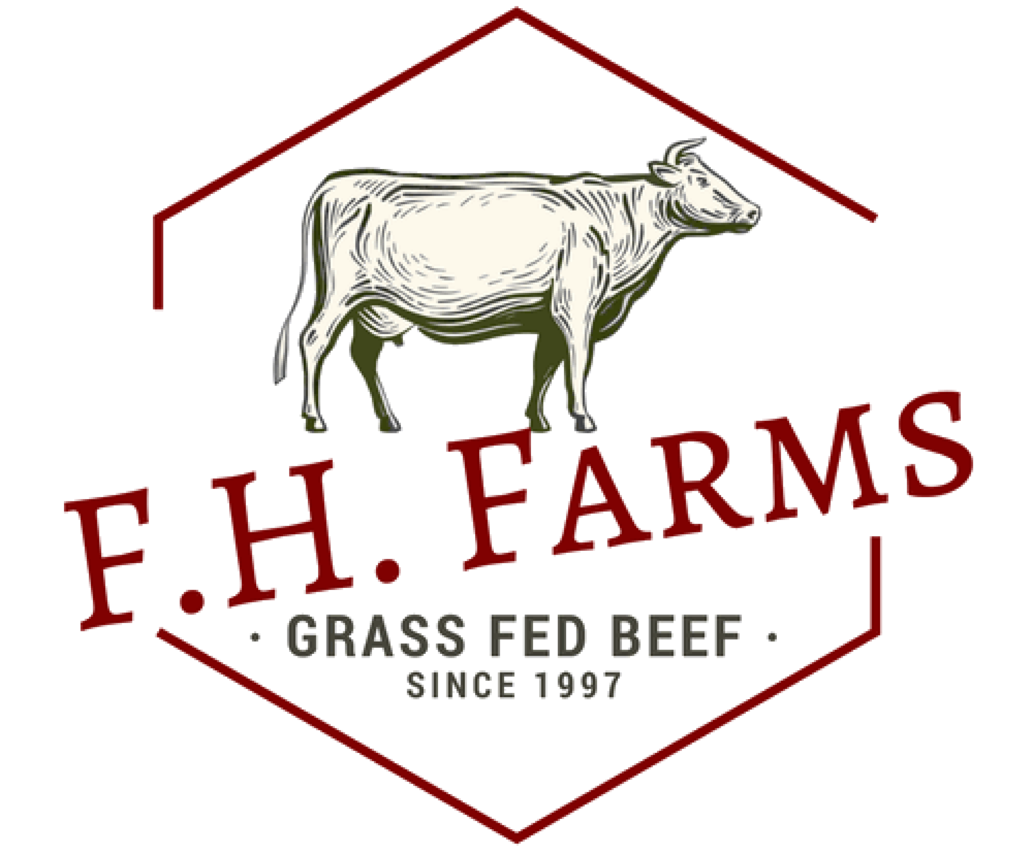
F.H. Farms
Mission: We product [sic] the highest quality grass fed beef, without antibiotics, hormones, or grain finishing. We want our customer to not only taste the difference, [sic] but feel the difference in health benefits.
Description: 25-acre sustainably-focused, grass-fed and -finished farm in Granville, Ohio
Products & Services: Beef
CMS: Worpress

Slide 5
F.H. FARMS (CONT’D)
Strengths:
  Good photos and incredible cut descriptions on site
Weaknesses:
  Some cuts of meet are more expensive
  Site built on Wordpress, which is an open-source CMS that is known for security risk issues. Site is also not optimized well.
Opportunities:
  Create a better ecommerce experience
  Some cuts of meet are more expensive
Threats:
  Some cuts of meet are less expensive

Slide 6

BUCKEYE VALLEY COOP
Mission: To provide a safe, local, healthy source of naturally raised beef, while at the same time, strengthening our local economy and preserving the traditions and heritage of family farms in our area.
Description: Farmer-owned coop in Southern Ohio. This isn’t a true competitor, so not SWOT analysis was completed.
Products & Services: Beef
CMS: Wix

Slide 7

RED MOON RANCH
Mission: N/A
Description: First-time agricultural family with ranch in South Vienna, Ohio
Products & Services: Beef, pork, chicken, lamb, and chicken and duck eggs
CMS: GrazeCart

Slide 8
Red moon ranch (CONT’D)
Strengths:
  Adorable photography
  Offer pick-up in Worthington on Saturdays from 9AM – 12PM
  Offer unique products like beef bacon and beef brats
Weaknesses:
  Higher costs for some cuts
Opportunities:
  Surpass in search engine results with well-built SEO and offer users a better ecommerce experience
  Understand why costs differ in products
  Blog and recipes on site are brand new additions
Threats:
  Lower costs for some cuts

Slide 9
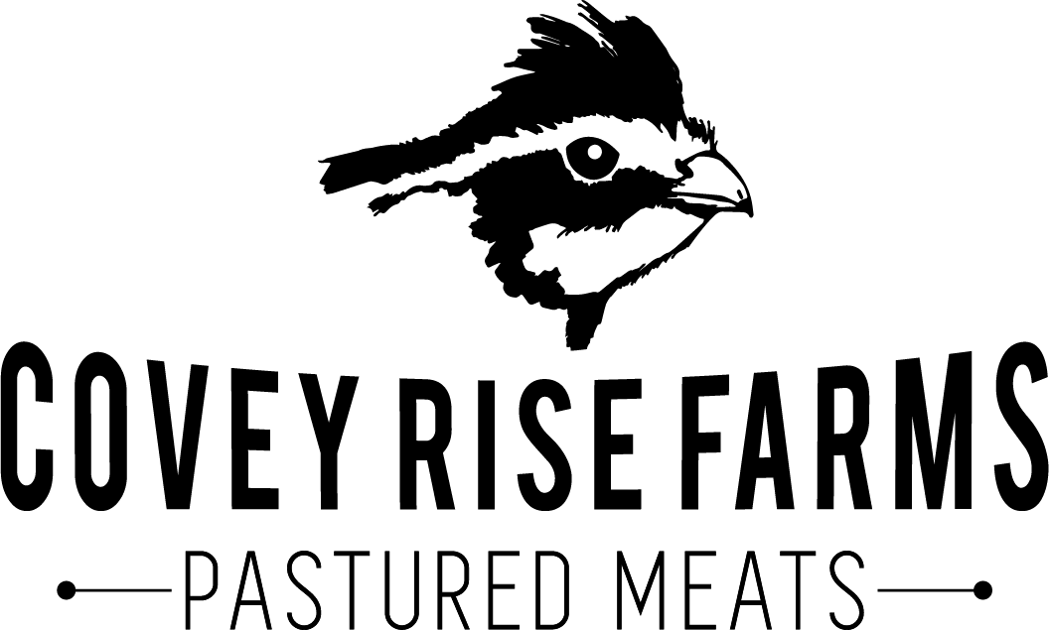
COVEY RISE FARMS
Mission: The mission of Covey Rise Farms is to provide ecologically and morally superior agricultural products while continuing to enhance the land and provide agricultural education.
Description: Small farm and bee colony in Radnor, Ohio
Products & Services: Pastured chicken, eggs, lamb, pork, turkeys, honey, soap
CMS: GrazeCart

Slide 10
Covey rise farms (CONT’D)
Strengths:
  Beautiful website with imagery that grabs the viewer
  Blog/Recipe content available on website
Weaknesses:
  Some areas of the website (recipes, blog) not updated frequently
Opportunities:
  Potential partnership considering different offerings
Threats:
  N/A

Slide 11
GAP ANALYSIS
Despite the available competition in the market, CABB Farms has an incredible opportunity to surpass competitors. CABB offers similar-grade, if not better-grade products, at comparable prices, and direct competitor websites lack in a truly consumer-centric, mobile- and ecommerce-first approach.
Keyword-rich, optimized content and a content delivery calendar/cadence that will easily push CABB Farms to the top of search engine results. As part of this content, CABB will need to get fresh photography and consider video.
Competitors aren’t utilizing Google My Business well, therefore they aren’t showing up in the Local 3-Pack. This is a huge opportunity for CABB Farms.
CABB has an opportunity to create a brand persona, Hadley, to help with content creation.

Slide 12
POINT OF SALE ANALYSIS

Slide 13
Point of sale current landscape
CABB’s current POS system is Square. Square allows for an easy consumer experience in person, however, the inventory and weighing leaves much to be desired.
Many competitors use two POS systems: one that allows for in-person commerce and one that does the heavy lifting of inventory and weighing.
Some POS systems come with built-in website hosting and templating, but CABB has already purchased a standalone hosting service.
Facebook polls show Barn2Door as a preferred POS system vendor for grass-fed beef farmers.

Slide 14
POS Systems analyzed
GrazeCart
Barn2Door
Findings of the following not included as they were not deemed viable options:
Brilliant POS
National Retail Solutions
Cafe Cartel

Slide 15

GrazeCart
Benefits:
  Website Builder comes with blog and recipe tools
  Sell by weight
  Sell via pick-up locations, shipping, wholesale
  Easily manage inventory
Cost:
  $124/month for 100 sales
  2.9% + $0.30/transaction
  OR
  $275/month for 500 sales
  2.9% + $0.30/transaction

Slide 16
Barn2door
Benefits:
  Website Builder comes with blog tool and can have recipe tool with scale option
  Sell via pick-up locations, shipping, wholesale
  Website offers Amazon-like experience with on-page filtering options
  Buyer chat support
Cost:
  $99/month for 500 sales
  $499 one-time set up fee
  OR
  $149/month for unlimited sales
  $599 one-time set up fee

Slide 17
RECOMMENDATION
Barn2Door offers a fantastic point of sale system but requires that their team develop and build the site. Page load speeds for the Barn2Door shops is also a big sluggish.
GrazeCart offers a faster page load speed and limited template options but can be used in existing website, ecommerce design.
After all fees are taken into consideration, the difference is relatively nominal.
RECOMMENDATION: GRAZECART

