Slide 1
CABB FARMS PERSONAS & CUSTOMER JOURNEYS
PREPARED MARCH 2021

Slide 2
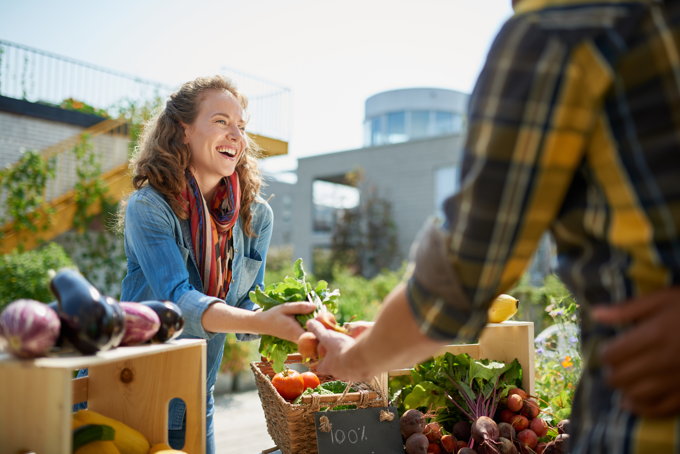
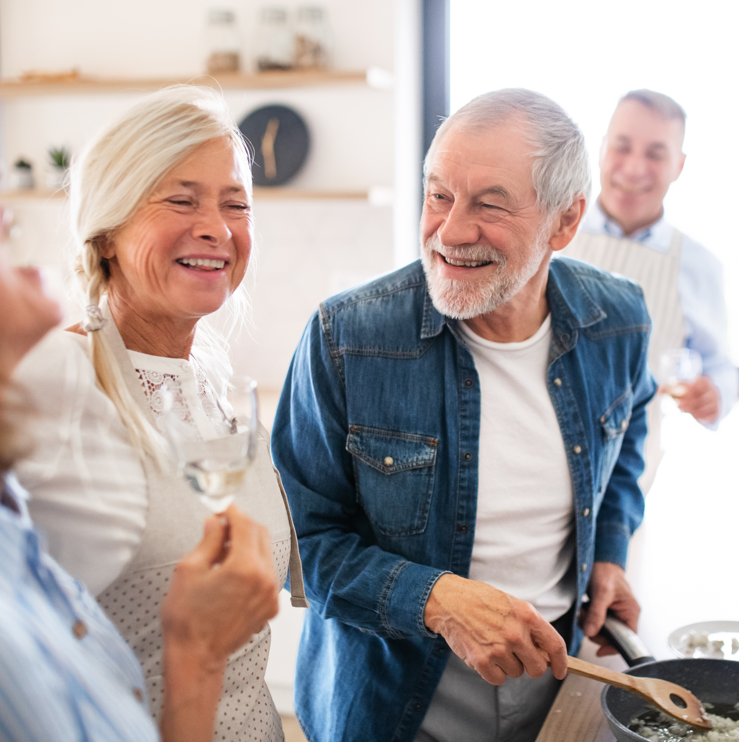
PERSONAS
BRITANNI
FEMALE
25-34
KATIE FEMALE
35-44
JEAN
FEMALE
45-54
PHIL
MALE 55 - 64

Slide 3
BRITANni
Britanni is the manager of a dental practice in Worthington, Ohio. Britanni is married and just learned that she is expecting her first child. Always focused on her health, she wants to ensure that both she and baby eat the best, most nutritious foods possible. A frequenter of farmers markets for her produce, Britanni has recently found herself interested in finding a good replacement for the meats she typically buys from the grocer so she can reduce the ingestion of hormones or antibiotics. LIFESTYLE:
Works Monday – Friday, 40 – 45 hours and an occasional evening or weekend
Works out for 30 – 60 minutes daily; attends a yoga class at the gym regularly
PERSONALITY:
Compassionate and caring, dedicated and willing to go the extra mile at work, at home and with friends
GOALS:
Evaluate and compare all options available to her during her pregnancy
Eat as healthily as possible
CHALLENGES:
Balancing work, personal, and family time
SHOPPING ACTIVITY:
Prefers online shopping
Seeks out natural, healthy foods from trustworthy venues
GENDER | Female
AGE | 28
GENERATION | Millennial
STATUS | Married
KIDS | Pregnant with 1st
CAREER | Manager
INDUSTRY | Healthcare
INCOME | $40,652
EDUCATION | BBA

Slide 4
BRITANNI’S JOURNEY
 | AWARENESS | RESEARCH | ACQUISITION | ENGAGEMENT | SERVICE | LOYALTY
LOCAL 3-PACK
SEARCH ENGINES
SOCIAL
FARMERS MARKET
WEBSITE
EMAIL
IN PERSON RECOMENDATION
3
4
5
10
7
8
8
6
11
9
1
2
Notes:
1 – Finds out she is pregnant; has important conversations with doctor about nutrition and what to eat while expecting.
2 – Discusses nutrition with regular yoga class at the gym.
3 – Googles “hormone-free beef near me”.
4 – Researches beef suppliers at local Worthington Farmer’s Market where she frequents.
5 – Asks “Worthington Mom’s in the Know” group on Facebook for recommendations on beef suppliers.
5 – Visits website to learn more.
6 – Visits Worthington Farmer’s Market to learn more.
7 – Stops at booth at Worthington Farmer’s Market.
8 – Purchases ground beef in person and asks about online shipping.
9 – Signs up for email notifications for when online purchases are available.
10 – Follows on Facebook.
11 – Checks website regularly for online options.

Slide 5
KATIE
Katie is a psychology professor at Otterbein University in Westerville, Ohio. Katie is married with two children ages 13 and 10 and has a dog. Katie often volunteers at the Westerville Farmers Market, as she is free most of the summertime. A busy mom, Katie juggles many priorities and wants to get a healthy, easy dinner on the table for her equally busy family. LIFESTYLE:
Works Monday – Friday, 50 – 55 hours from mid-August to mid-June
Volunteers at Farmers markets on weekends
Busy taking kids to extracurricular activities
PERSONALITY:
A warm, loving, dedicated, accessible wife and mother
Punctual and patient
GOALS:
Raise two healthy, happy kids who keep busy and do well in life
CHALLENGES:
Balancing work, personal, and family time
SHOPPING ACTIVITY:
Seeks out convenience
GENDER | Female
AGE | 39
GENERATION | Xennial
STATUS | Married
KIDS | 2 kids, ages 13 and 10
CAREER | Professor
INDUSTRY | Education
INCOME | $89,200
EDUCATION | PhD

Slide 6
KATIE’S JOURNEY
 | AWARENESS | RESEARCH | ACQUISITION | ENGAGEMENT | SERVICE | LOYALTY
LOCAL 3-PACK
SEARCH ENGINES
SOCIAL
FARMERS MARKET
WEBSITE
EMAIL
IN PERSON RECOMENDATION
3
2
1
6
7
7
8
4
9
5
Notes:
1 – Volunteers at Westerville Farmers Market and sees CABB booth. Has discussion with team there.
2 – Sees discussion about healthiness of beef on Westerville Mom’s in the Know Facebook group.
3 – Googles difference between beef types (organic, grain-fed, grass-fed, etc.)
4 – Visits website to learn more.
5 – Talks to friend who also volunteers at the Farmers Market who gives a recommendation.
6 – Visits booth again at next Farmers Market to learn more.
7 – Purchases a roast for the crockpot, summer sausage for a charcuterie board, and smoked dog bones for the dog.
8 – Because of the quality of the meat, becomes a regular at the Farmers Market booth.
9 – Visits website during winter months to purchase online products (when available)

Slide 7
JEAN
Jean is a recent retiree. She owned and operated her own financial advisement company in Dublin, Ohio. Jean and her husband have two grown kids and are expecting their first grandchild Jean has always been very health-conscious, but her husband who has focused more on his career than his health recently suffered a heart attack. So, Jean is making a concerted effort to purchase and cook food that is healthier and from local food sources. LIFESTYLE:
Retirement leaves Jean lots of free time to do whatever she wants
Jean does water aerobics twice a week, swims regularly, and plays golf with her friends
PERSONALITY:
Jean is easy to talk to, trustworthy, and a good communicator
Jean knows the value of a dollar and is very money-oriented
With Jean, family comes first, and she wants both she and her husband to be able to spend as much time with their grandchildren as possible
GOALS:
Keeping she and her husband as healthy as possible for as long as possible
Enjoying retirement
CHALLENGES:
Getting her husband to appreciate and eat healthy foods
SHOPPING ACTIVITY:
Jean prefers in-person visits to niche stores and markets so she can talk to the vendors and salespeople about the choices she’s making
GENDER | Female
AGE | 53
GENERATION | Generation X
STATUS | Married
KIDS | 2; ages 27 and 29
CAREER | Retired
INDUSTRY | Financial Advisor
INCOME | $77,570
EDUCATION | MSF, CFA

Slide 8
JEAN’S JOURNEY
 | AWARENESS | RESEARCH | ACQUISITION | ENGAGEMENT | SERVICE | LOYALTY
LOCAL 3-PACK
SEARCH ENGINES
SOCIAL
FARMERS MARKET
WEBSITE
EMAIL
IN PERSON RECOMENDATION
4
2
5
8
8
3
7
1
6
Notes:
1 – Jean spoke with her dietitian friend after her husband’s heart attack to figure out how she should change her diet. Her friend suggests whole grains, lots of greens, and lean, grass-fed beef
2 – Jean goes on to Google to find “grass-fed beef near Dublin, Ohio”, which leads her to the Worthington Farmer’s Market website
3 – The Worthington Farmers Market website links back to the CABB website where Jean learns more about the benefits of grass-fed beef.
4 – She returns to Google to figure out the closest location.
5 – Jean visits the Worthington Farmers Market to chat with the team at the booth in person.
6 – She doesn’t purchase anything, because she wants to learn more. She chats with her dietitian friend once more to make sure she was making a good choice and to get recipe recommendations.
7 – She emails the CABB team to find out when they’ll be at the Farmer’s Market again next.
8 – She visits the Farmers Market again to purchase flank steak to put on her and her husband’s salads.

