Slide 1
Beaufort Memorial Analytical Assessment
October 2021

Slide 2
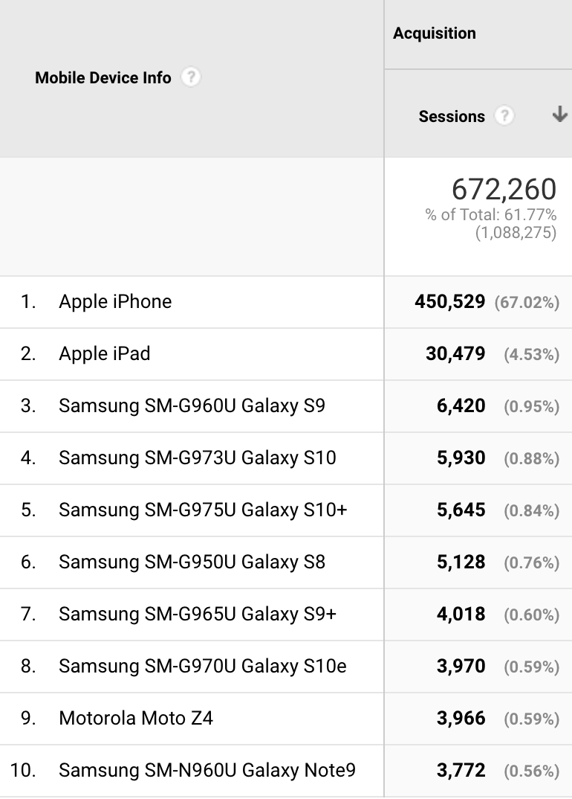
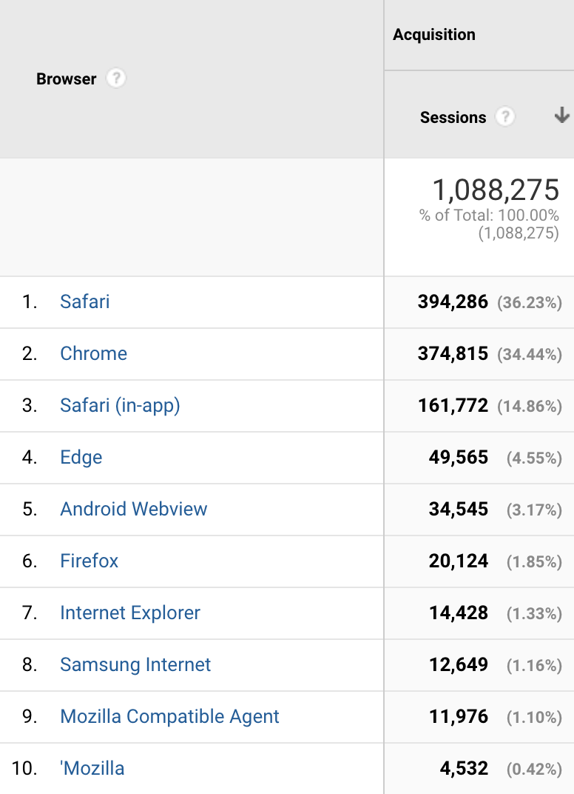
Analytics Overview October 1, 2020 – September 30, 2021
Notes:
57.58% of traffic is coming from mobile devices, which further indicates the need to be mobile-first. Apple is far outperforming other device types.
38.11% of traffic is coming from desktops.
Of additional importance, mobile users are far more likely to complete a goal/conversion as created by whoever set up your account:
21,488 goal completions by mobile users
1,409 goal completions by desktop users
98 goal completions by tablet users

Slide 3
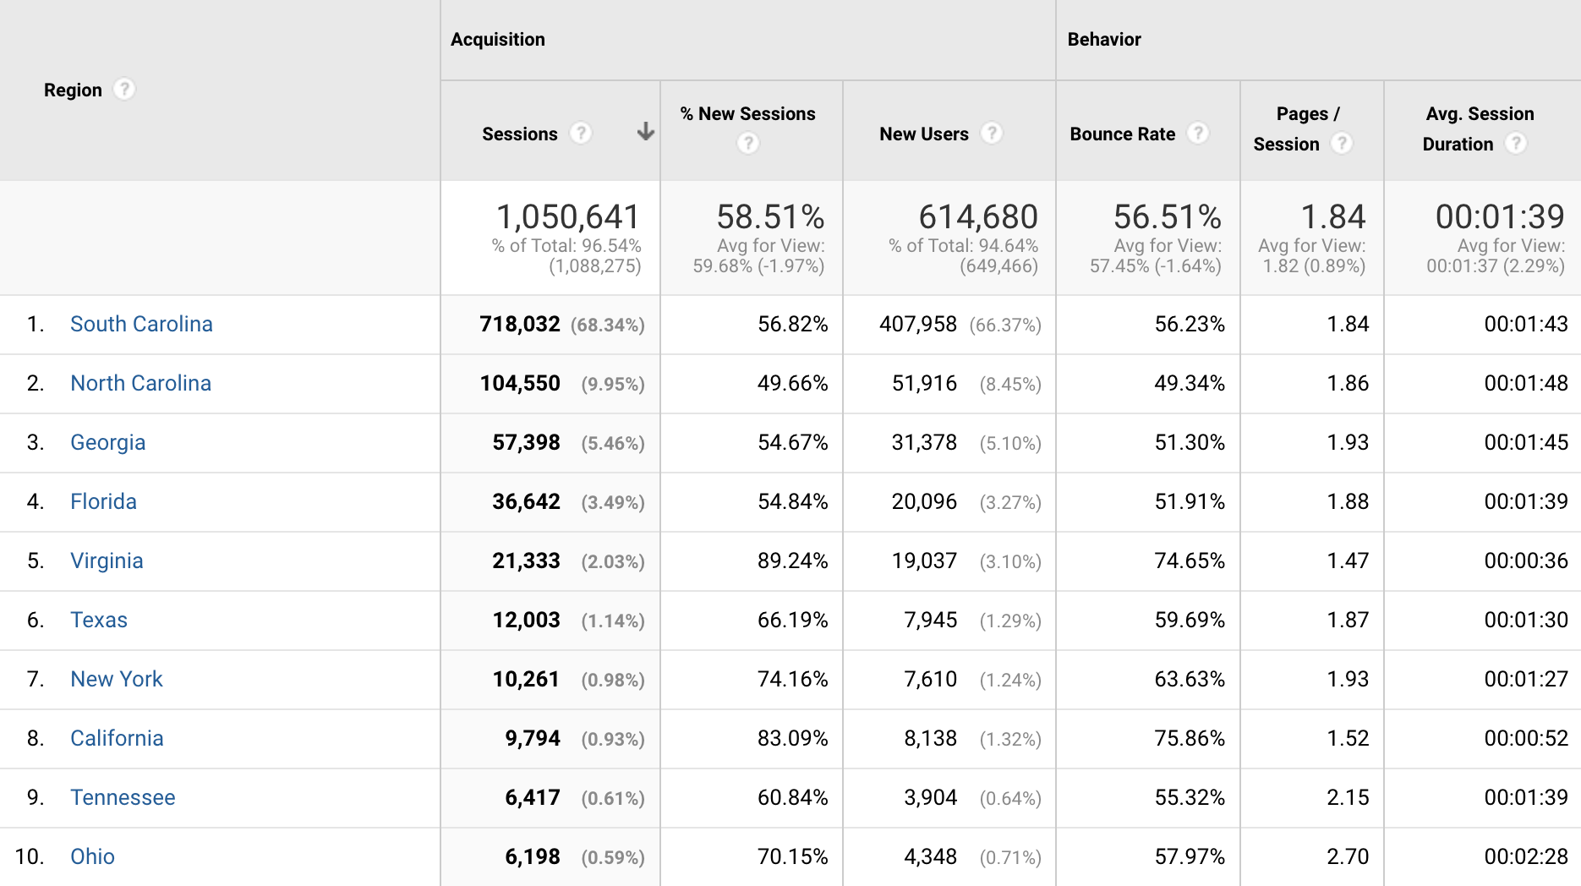
National Geography
Notes:
As expected, the majority of your traffic is coming from South Carolina.
Where is True North located? I’m surprised by some of these: Texas, New York, California
(Ohio is in there. Sorry!)

Slide 4
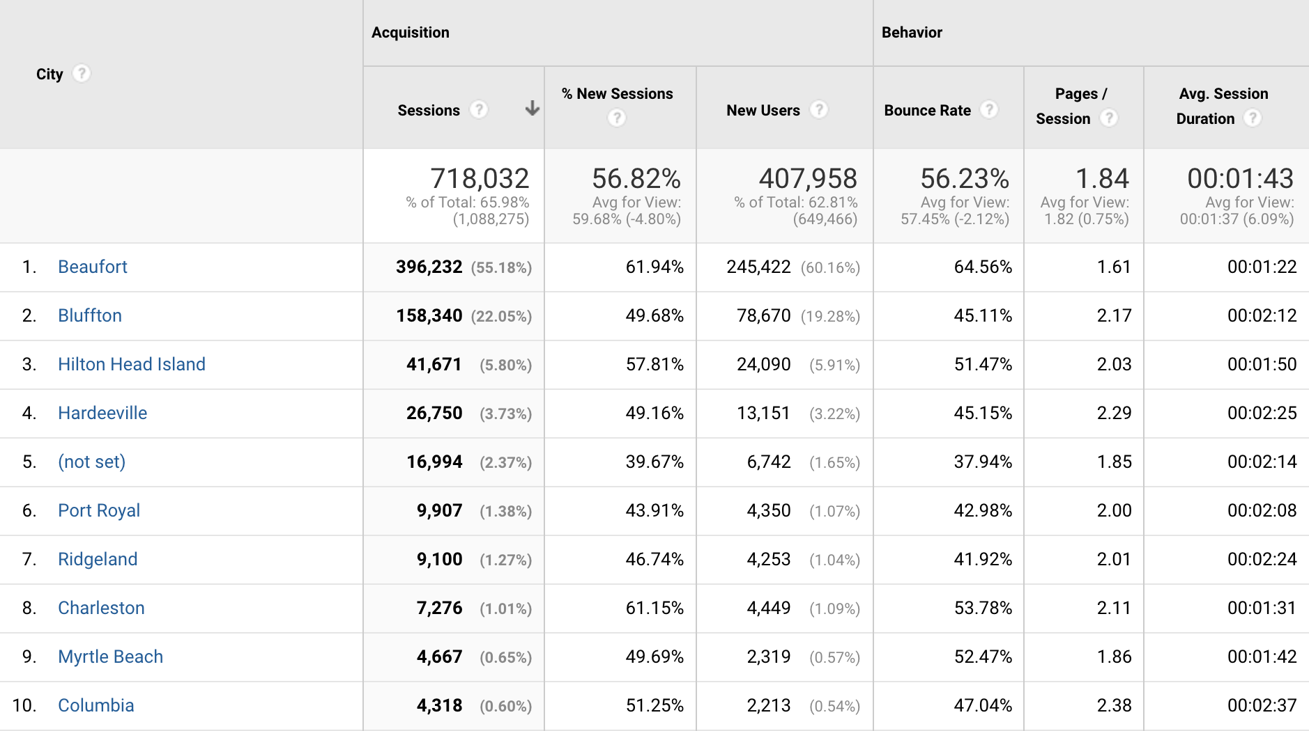
Local Geography
Notes:
Are any of these surprising to you?

Slide 5
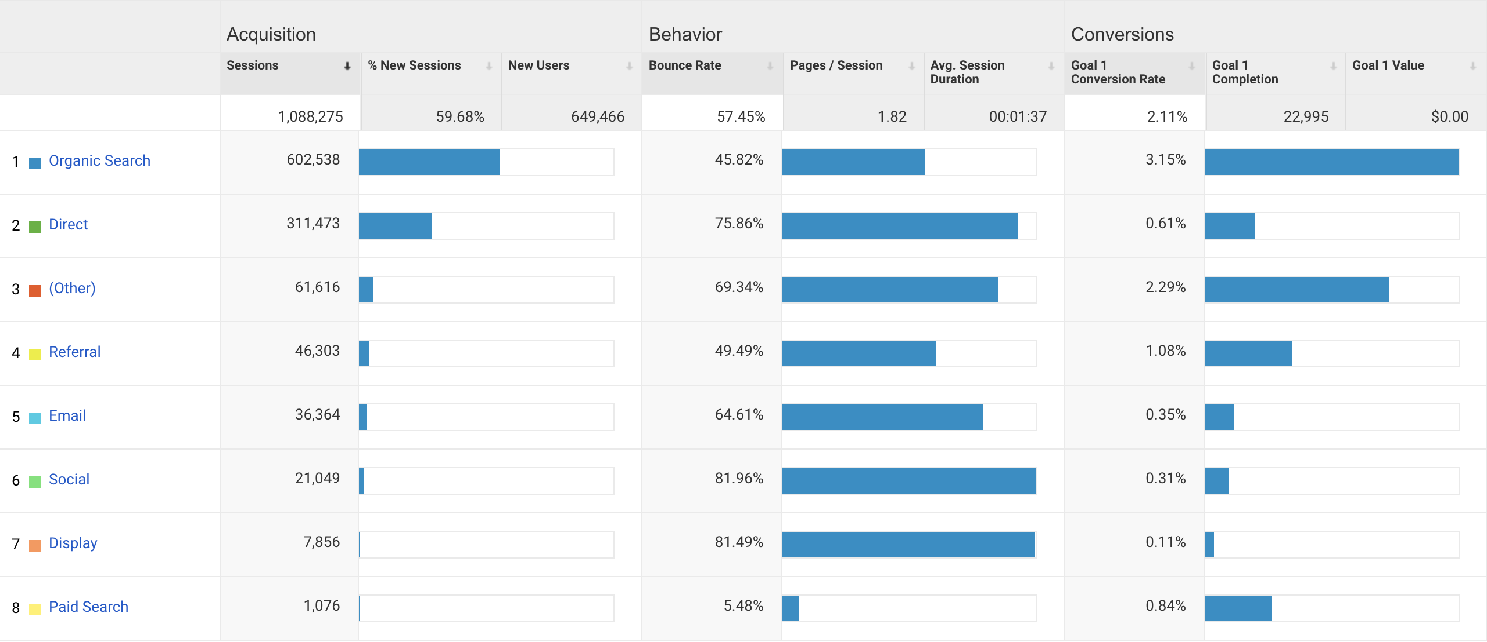
Acquisition
Notes:
Organic search is by far your best performer in terms of acquisition and goal conversion.
Referral and Paid Search bring in a decent percentage of conversions considering their acquisition rates.

Slide 6
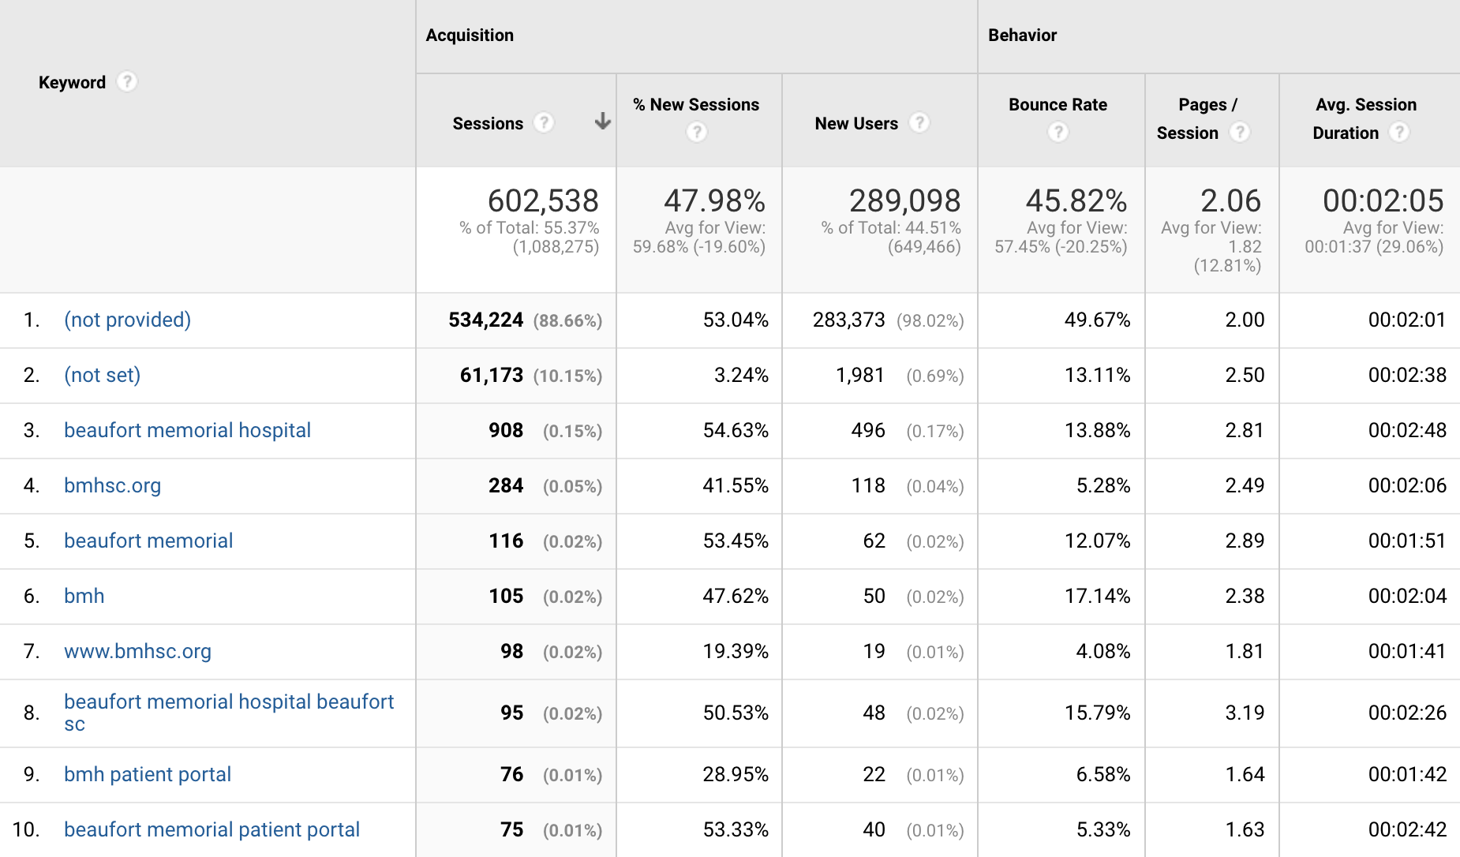
Organic Search

Slide 7
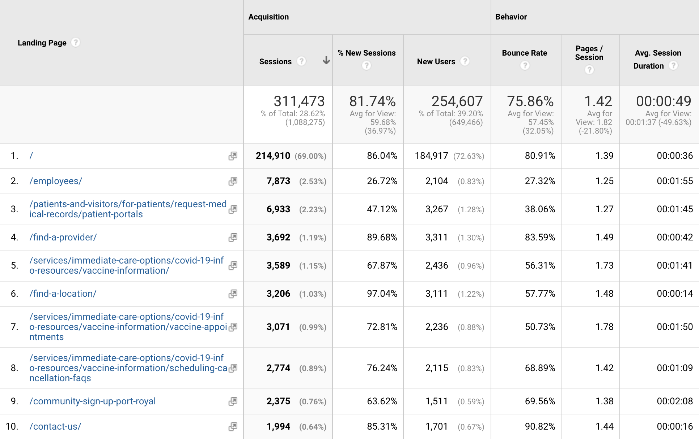
Direct Traffic

Slide 8
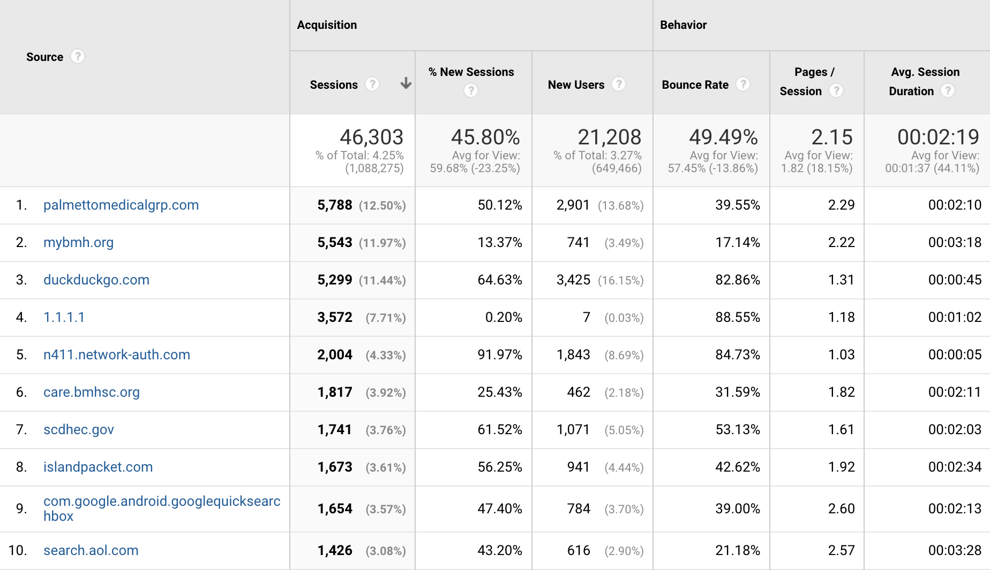
Referral Traffic
Notes:
Palmettomedicalgrp.com and islandpacket.com are interesting. What can you tell me about these?

Slide 9
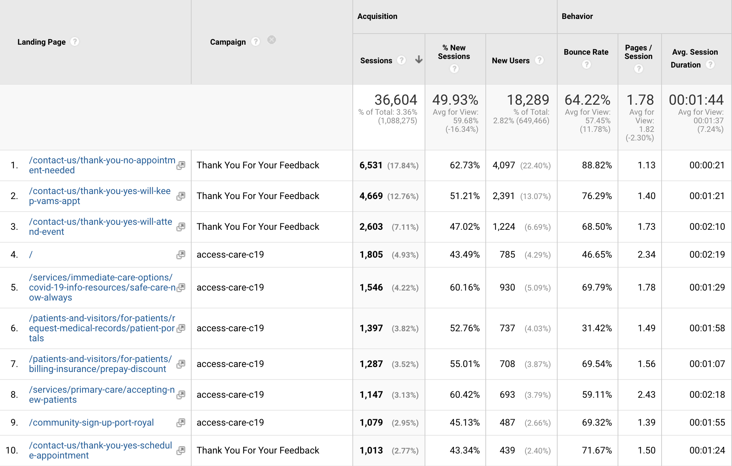
Email
Notes:
Thank You For Your Feedback – is this a general email sent to all patients post-visit?
What is the access-care-c19 email?

Slide 10
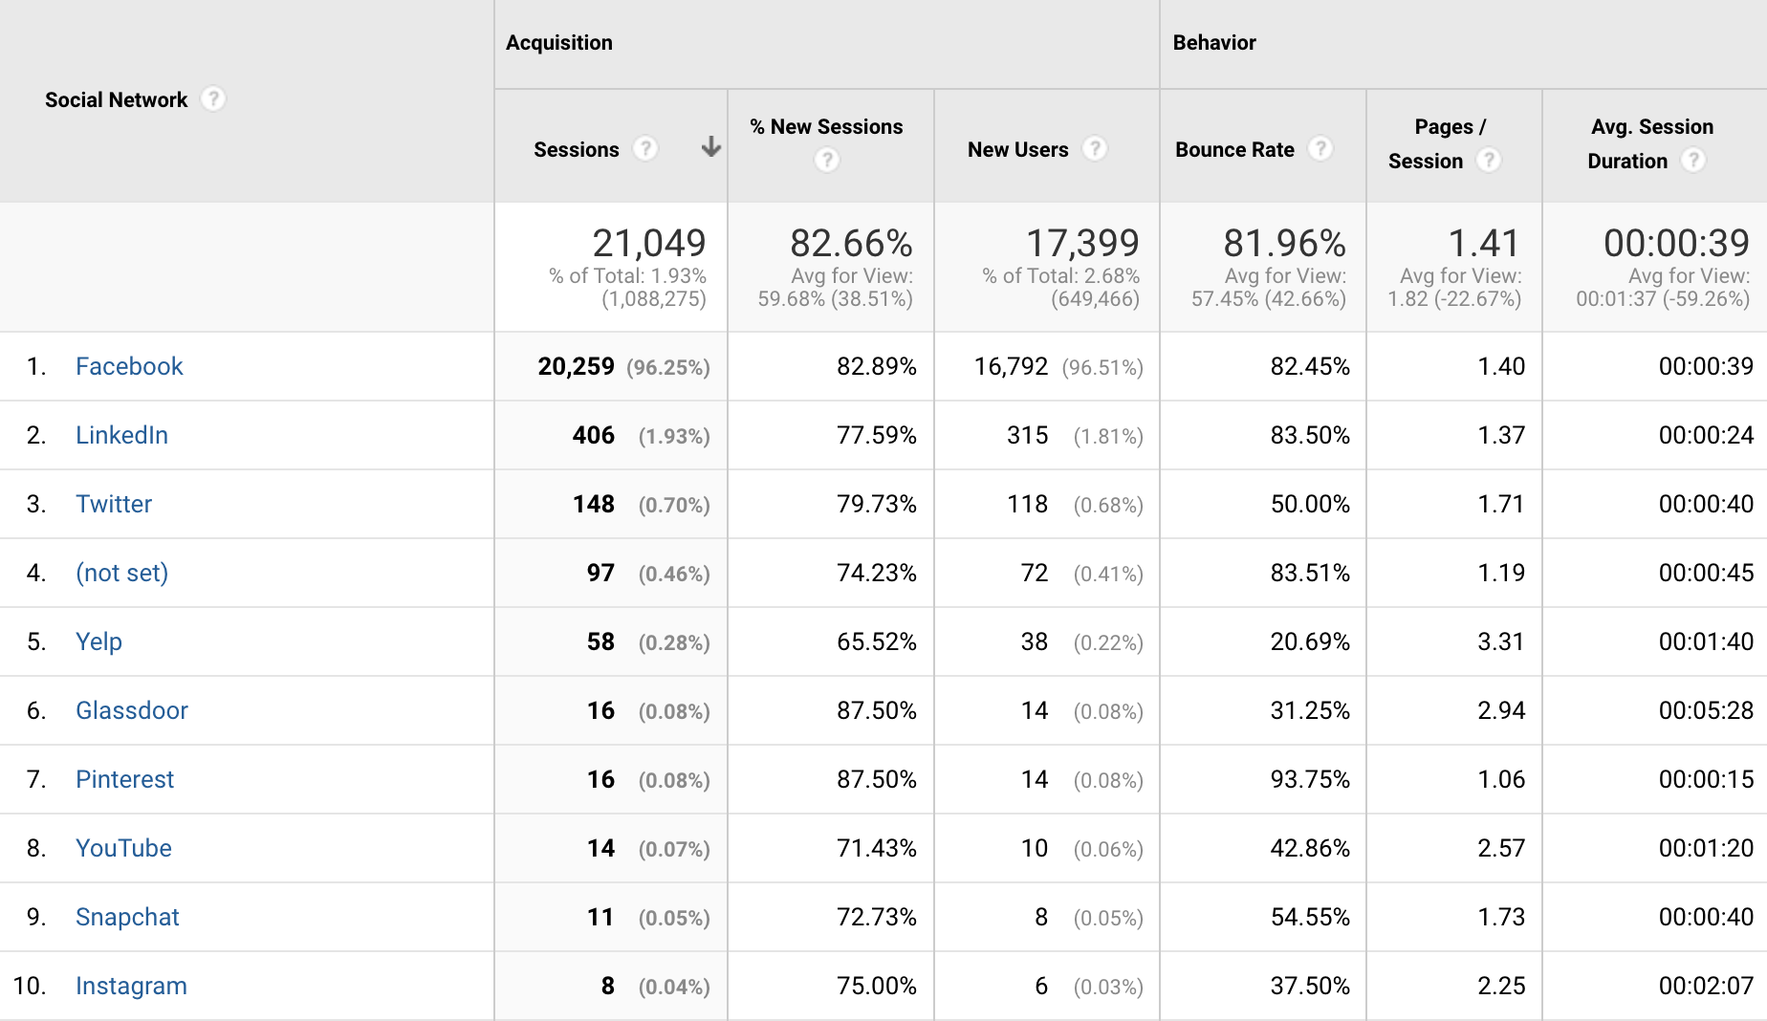
Social
Notes:
Facebook far outperforms the other social networks in terms of conversions 60 conversions for Facebook
1 for LinkedIn
3 for Yelp
1 for Snapchat

Slide 11
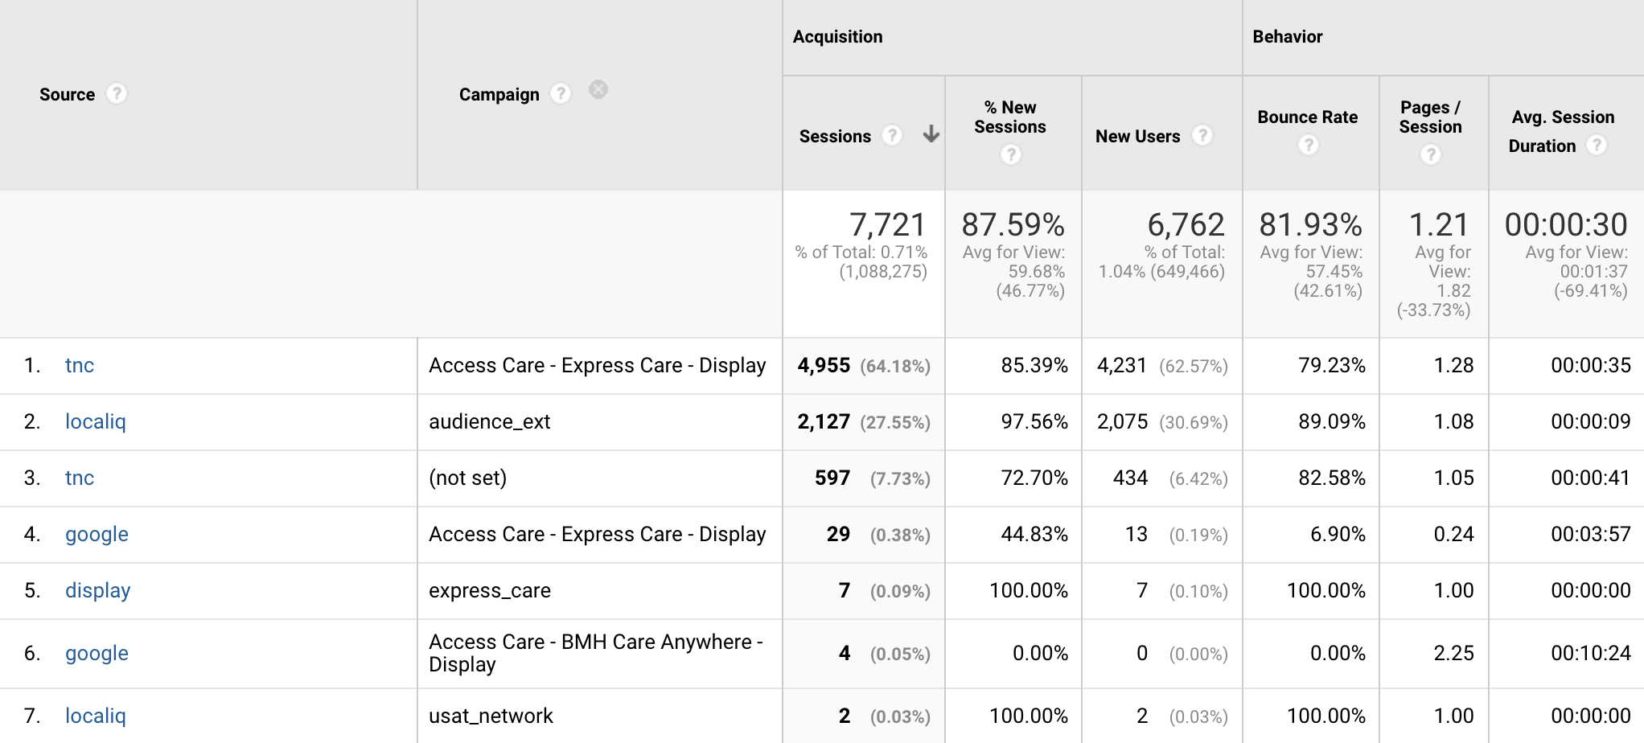
Display
Notes:
11 conversions in total, 9 of which are attributed to the True North Access Care – Express Care – Display campaign.

Slide 12
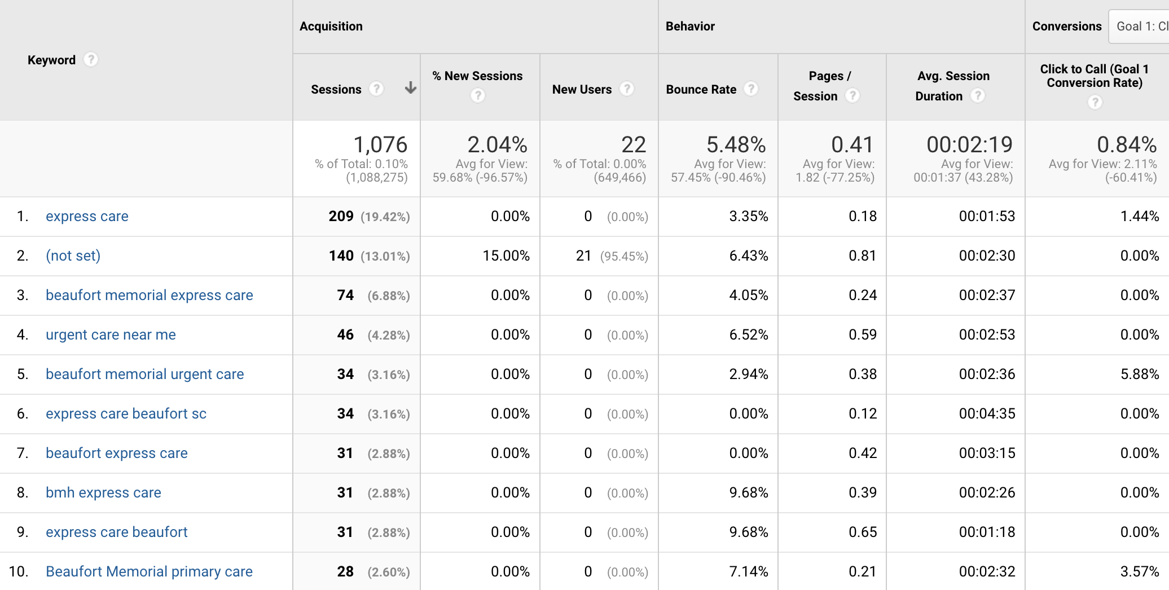
Paid Search
Notes:
9 conversions

Slide 13
Goals
Notes:
Click to call seems to be one of the only major “goals” being tracked. What else can we track?
Mammography appointment requests?
Baby University doesn’t seem to be registering goal completions. I presume people are still enrolling?
Should we consider asking your CFO what the cost of a new patients, mammography appointment, appointment request is in terms of “patient value” so we can ascribe some dollar amounts to these goals and conversions?

Slide 14
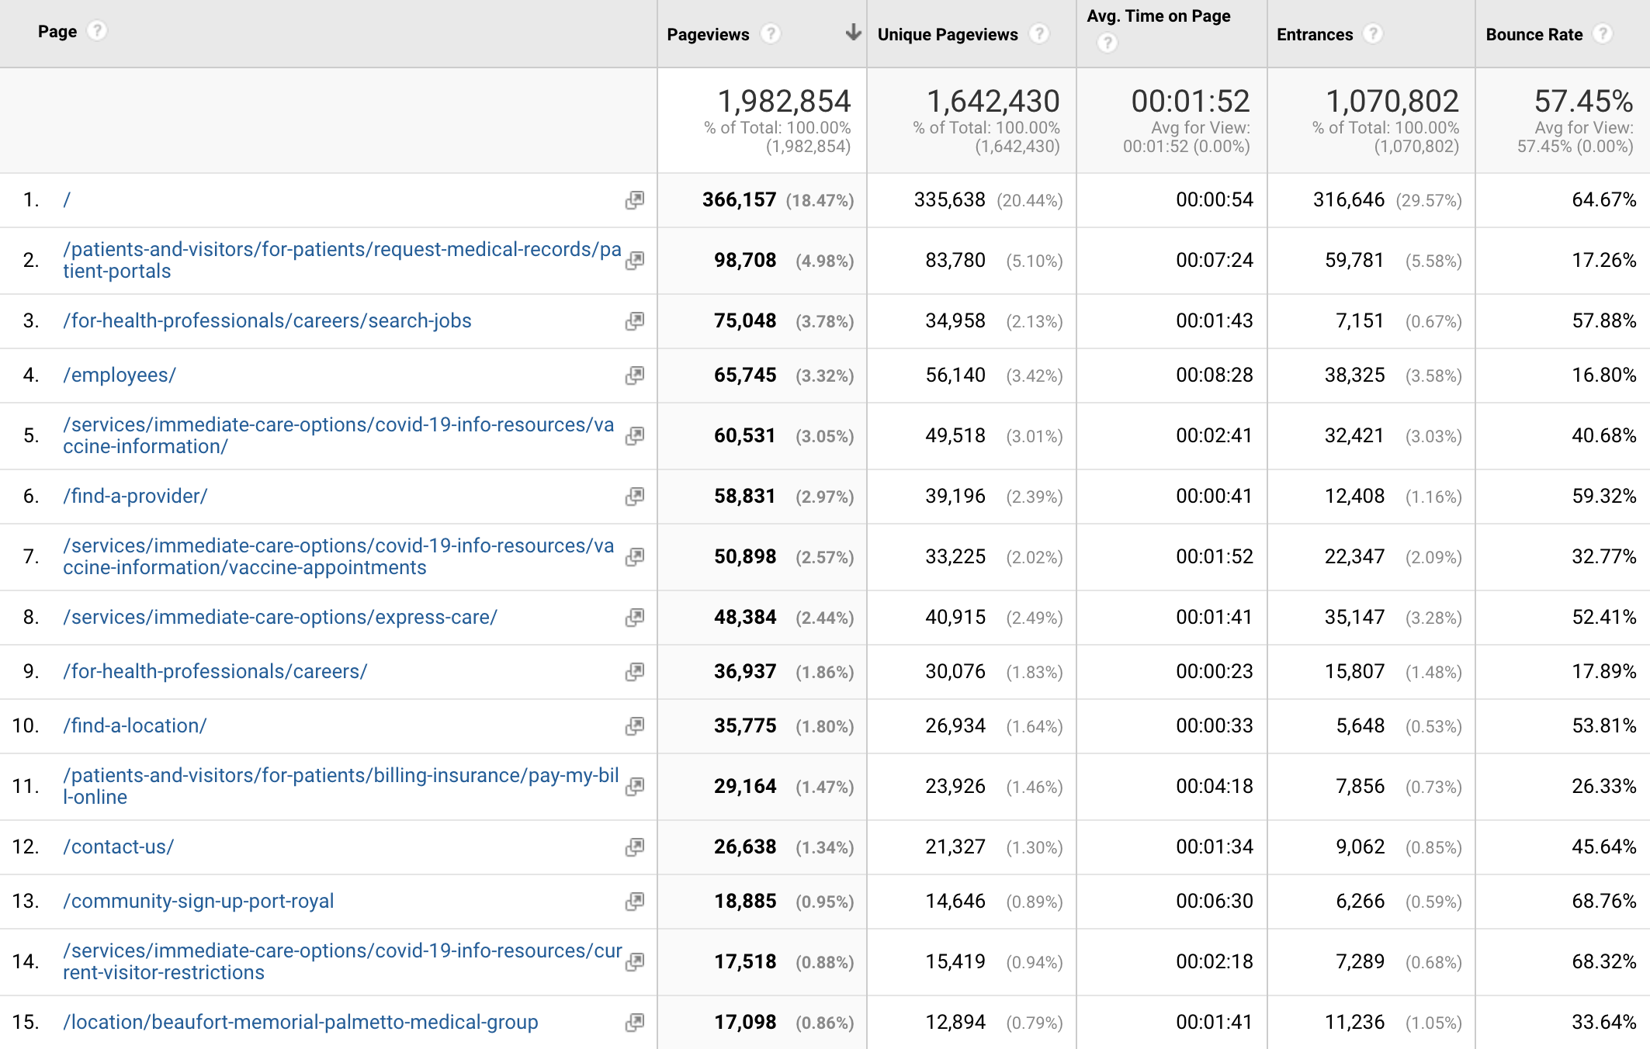
Top Visited Pages

Slide 15
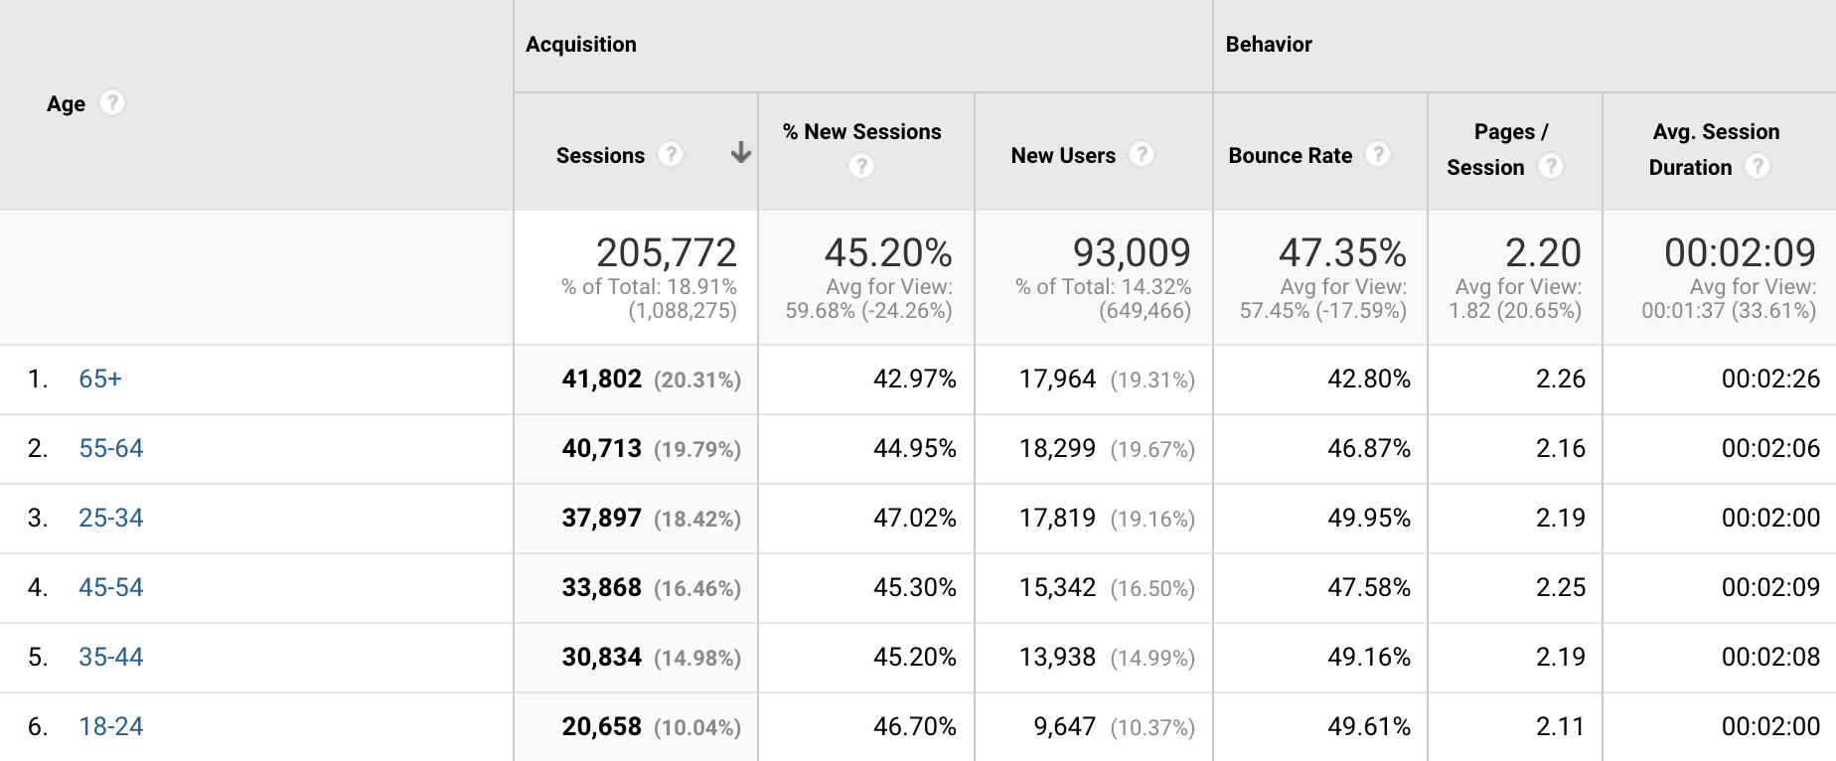
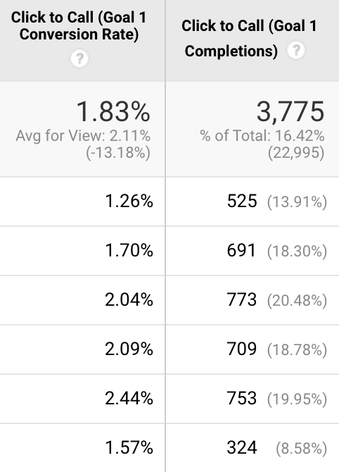
Site Traffic by Age Group

Slide 16
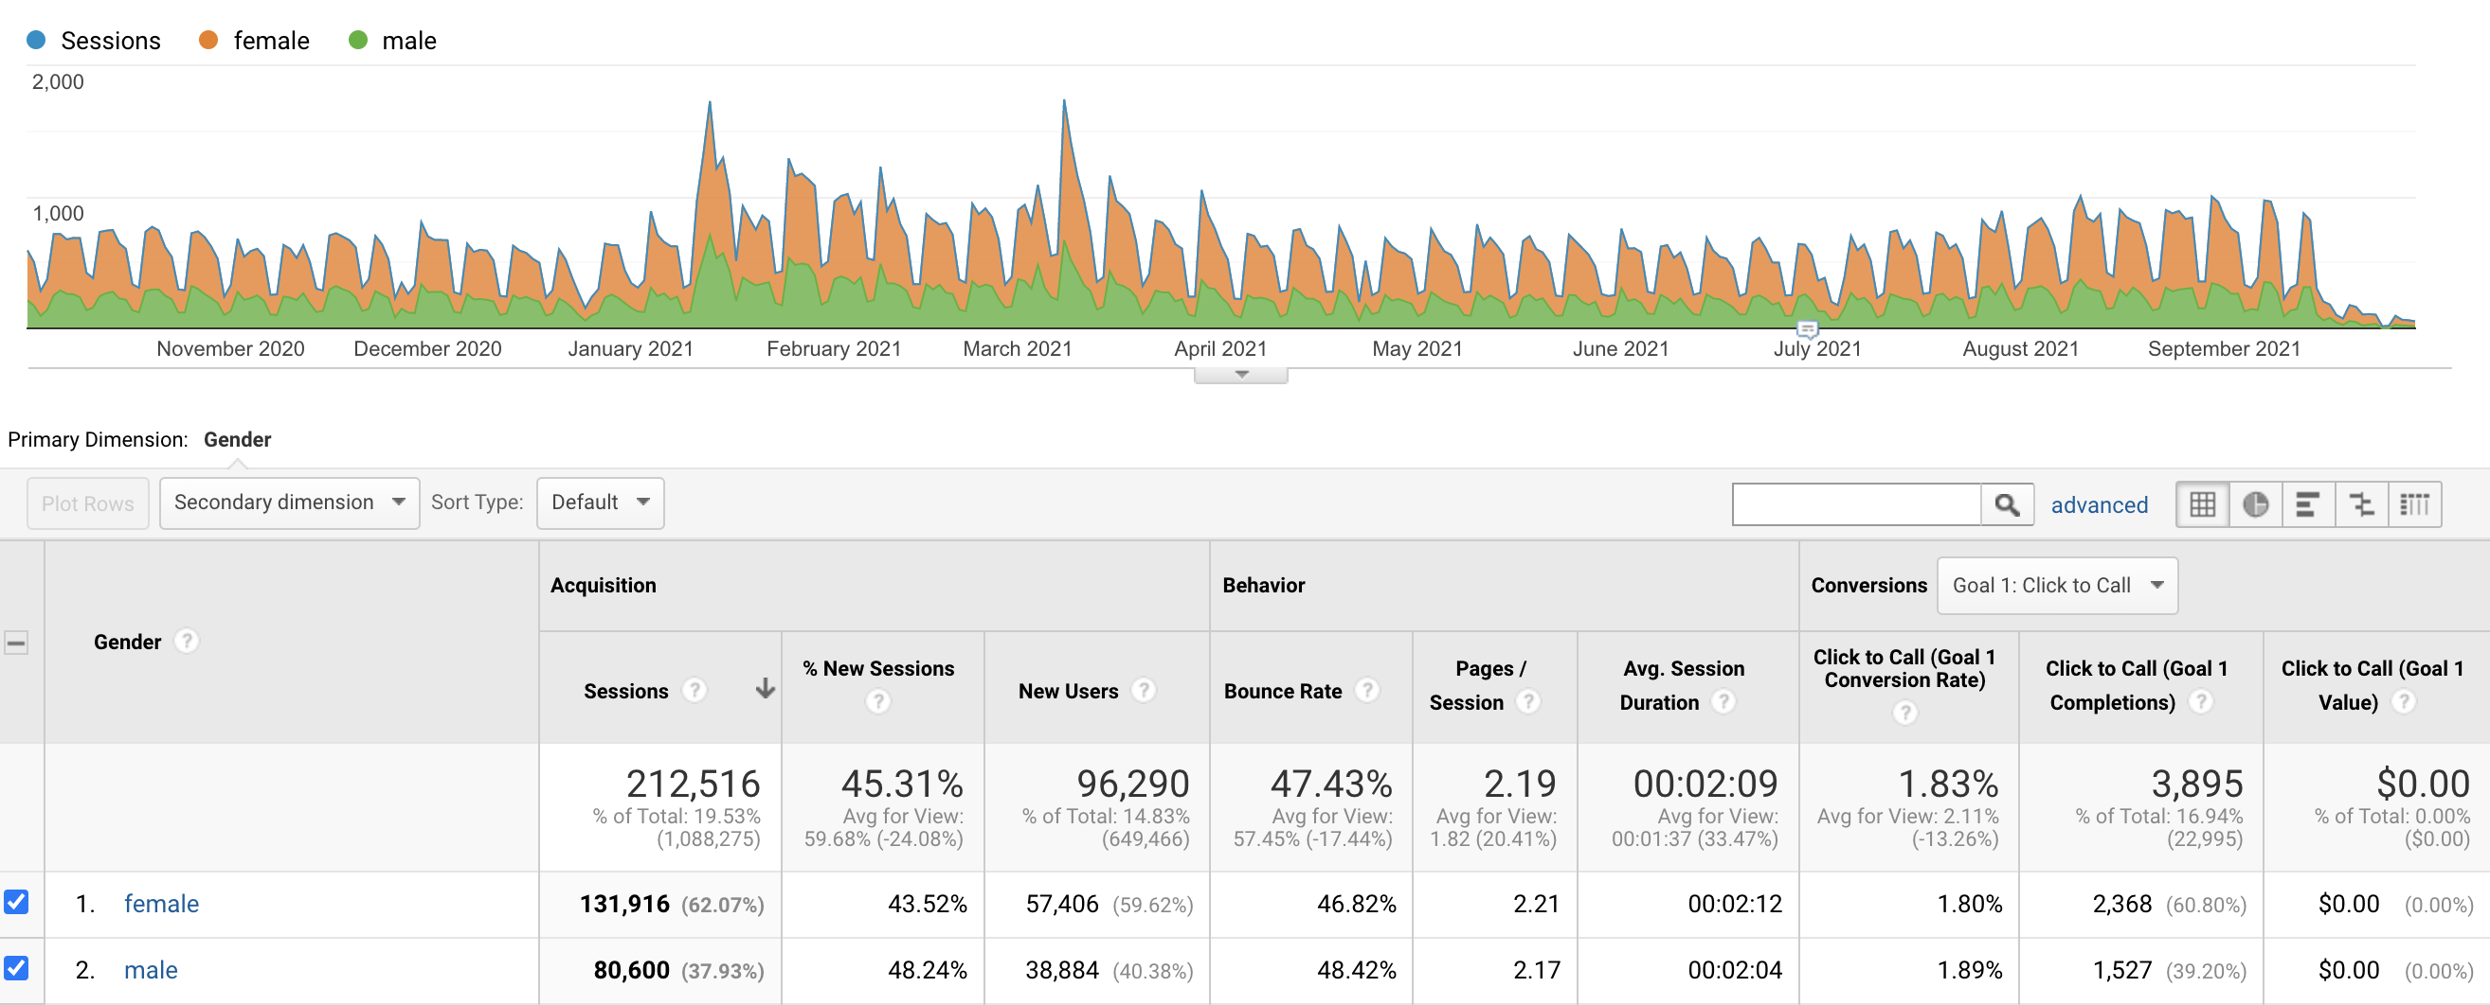
Site Traffic by Gender

Slide 17
User Funnel Flow from Home Page
Notes:
More mega menu dropdown is the most often used menu.
Most of the visitors to the megamenu are going to your Employees section.
Second is Patients & Visitors mega menu dropdown.
Pay Your Bill and Records Requests are most often sought out second path.
Third is Learn About Shots slider.
Most of these visitors are going to the COVID information page.
Fourth is Careers Dropdown.
What’s interesting here is that the Services dropdown does not account for a significant amount of traffic.
Services accounts for 5.6K actions, 6.29% of traffic from home page.
Pay Your Bill under quick links = 4.6K actions, 5.11% of traffic from home page.
Find A Provider menu = 3.8K, 4.26%
Find A Location – 2.2K, 2.49%

Slide 18
Thank You

