Slide 1

Website Performance Check-In
February 2022
Cassi Snyder
Web Engagement Lead

Slide 2
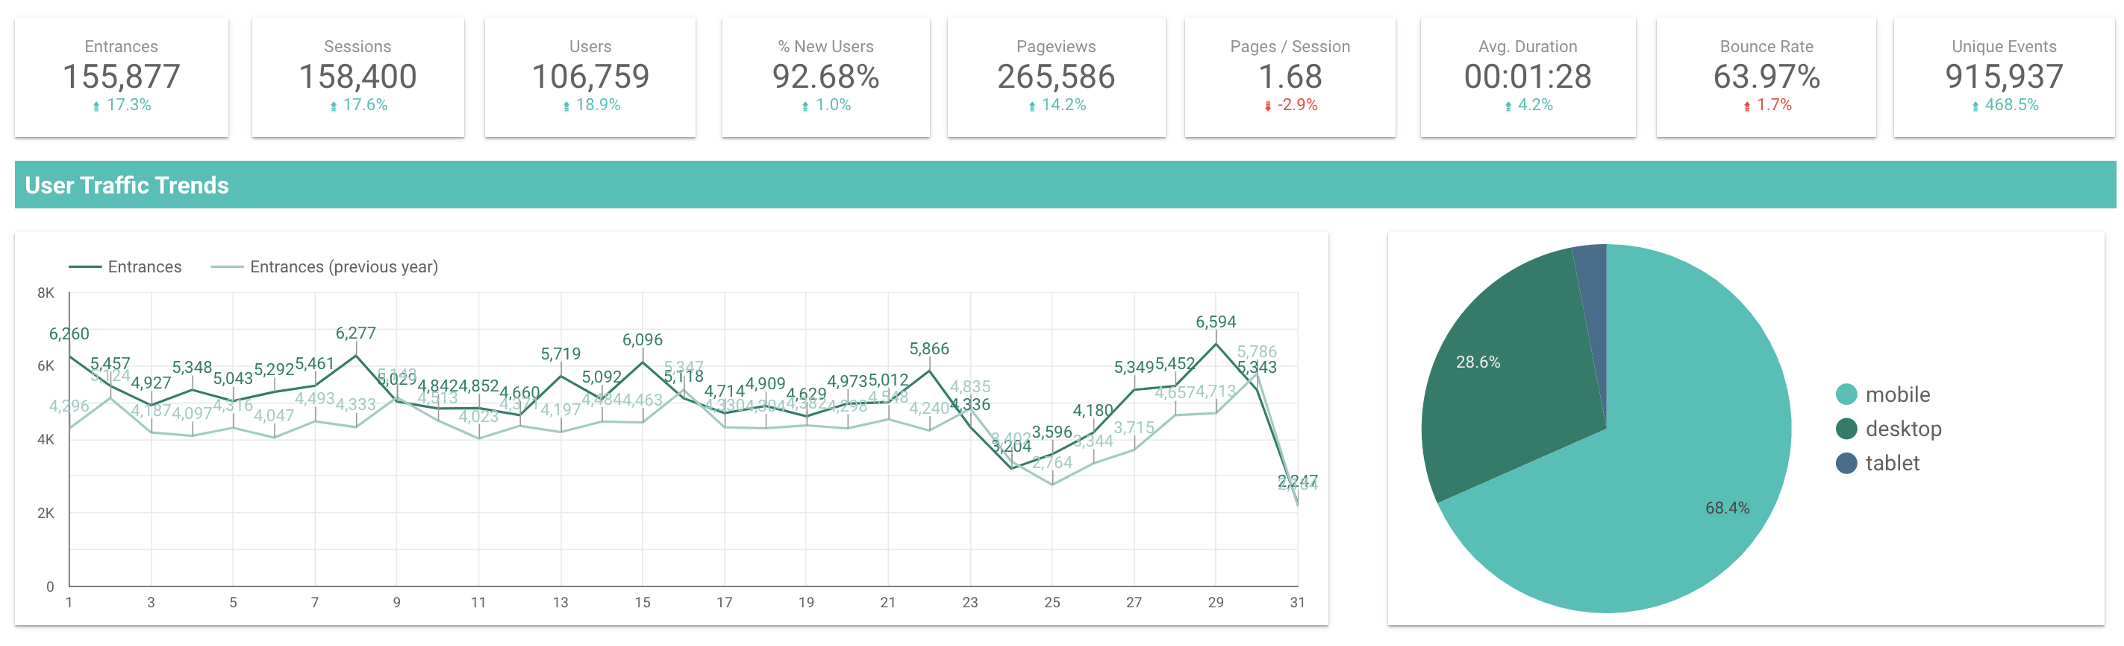
Website Performance Check-in | Q4 2021
Overall Traffic Insights:
17% increase in site entrances and sessions, despite being down a bit from Q3
  Increases in users, pageviews, pages/session, duration, and events
  VERY slight increase in bounce rate
Continued increase in mobile users: up 0.5% Q over Q, 0.3% decrease in desktop users Q over Q
Notes:
Q2 Notes:
Driving slightly less traffic but higher engagement rates
Increases in pageviews, pages/session, duration, and events
Seeing slight decline in entrances, sessions, and users
68.4% mobile users, 28.6% desktop, 3% tablet

Slide 3
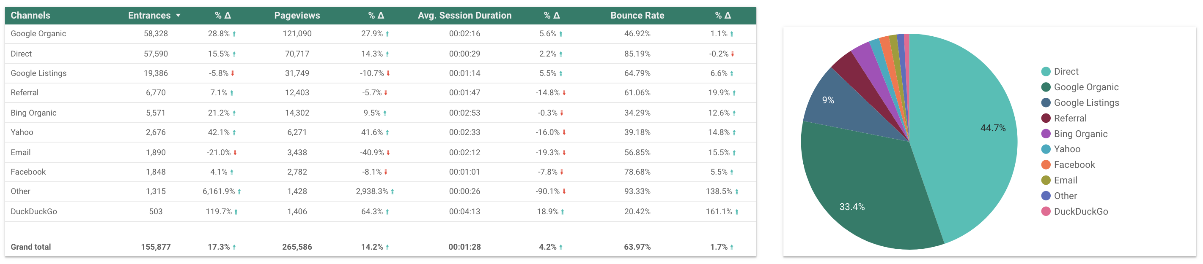
Channel Performance Check-in | Q4 2021
Traffic Changes by Channel:
6,161.9% increase in entrances from other
119.7% increase from DuckDuckGo
42.1% increase from Yahoo
28.8% increase from Google Organic
Only 4.1% increase in entrances from Facebook
21% decrease from Email
Notes:
Q2 Notes:
4.9% increase in entrances from direct
2,884% increase in entrances from other
67.5% decrease in entrances from Facebook
54.3% decrease in entrances from email
11.3% decrease in entrances from google organic
66.9% mobile users

Slide 4
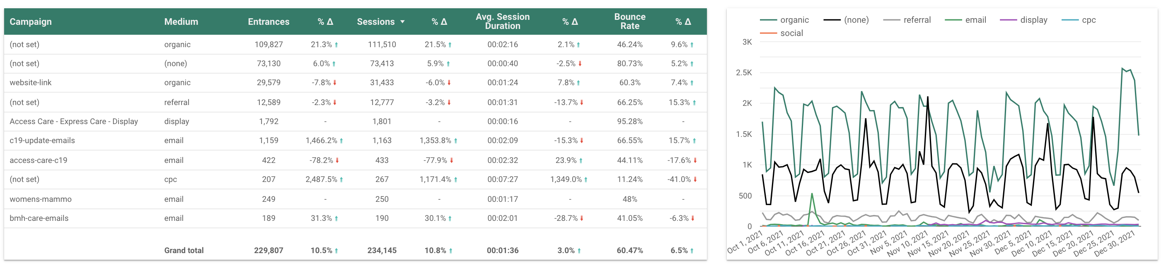
Campaign Performance Check-in | Q4 2021
Top Performing Campaigns:
2487.5% increase in (not set)
1466.2% increase in entrances from c19-update-emails
31.3% increase in entrances from bmh-care-emails
78.2% decrease in entrances from access-care-c19
7.8% decrease in entrances from website-link
Notes:
“website-link” is a redirect URL link for TNC
access-care-c19 was downloadable guide for covid-19

Slide 5
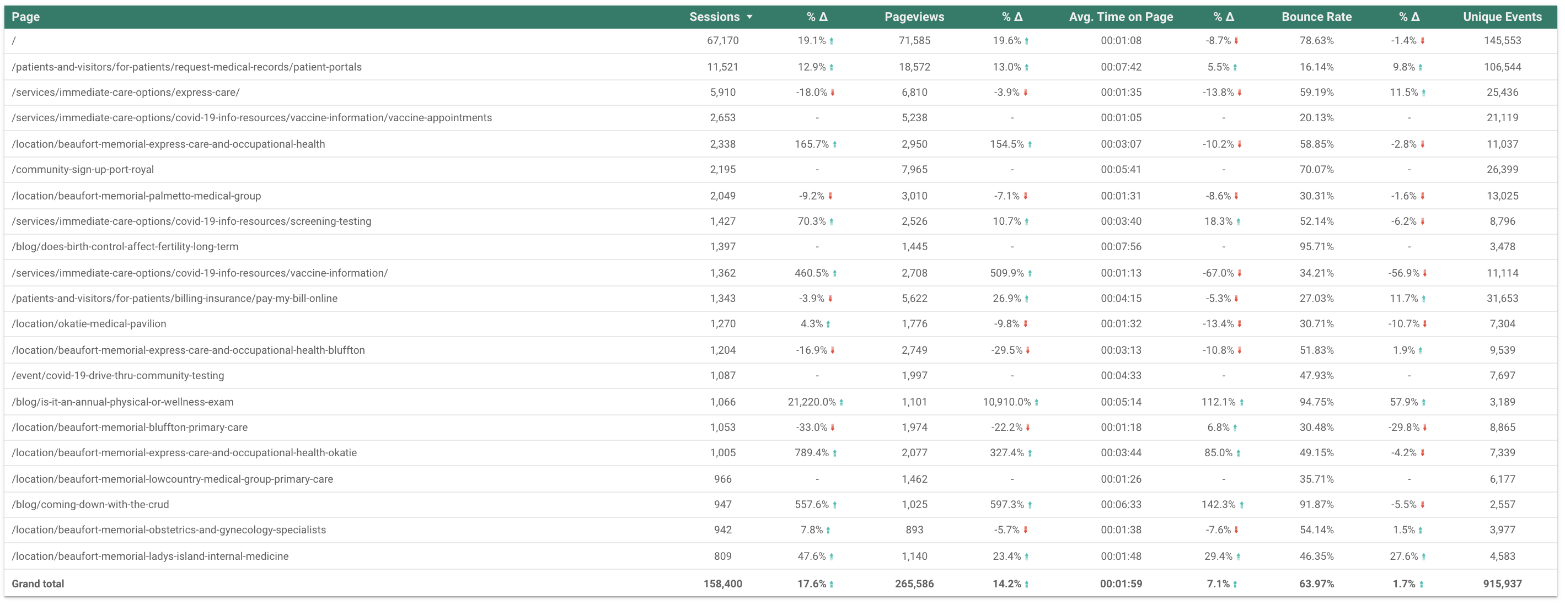
Content Performance Check-in | Q4 2021
Notes:
Location pages
Patient Portal
Vaccine sign-up
Immediate care and Express care pages
Blogs
Q3
/location pages
Immediate care pages
Bill Pay and Portal
COVID vaccines and testing

Slide 6
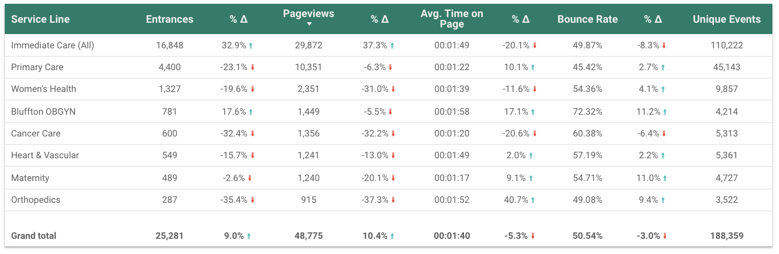
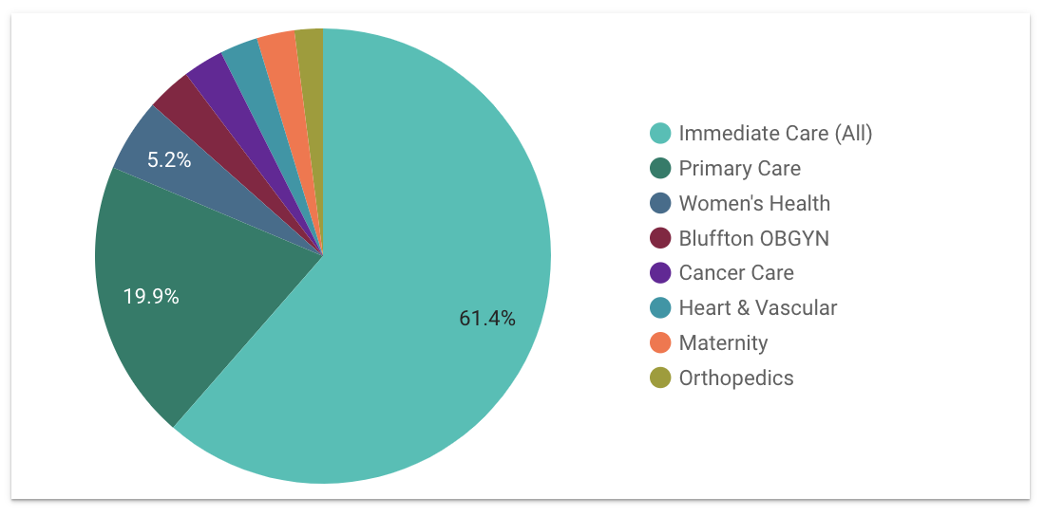
Service Line Performance Check-in | Q4 2021
Traffic by Service Line
32.9% increase in entrances to Immediate Care (down significantly from Q3)
17.6% increase in entrances to Bluffton OBGYN
32.4% decrease in traffic to cancer care
35.4% decrease in traffic to orthopedics***
Notes:
*** Comparing this report to the site content numbers in analytics, I am seeing only a 5.4% decrease from O3. Additionally, the average time on the page has increased 13.28% and the bounce rate has decreased 12.77%.
Q3 Notes:
196.8% increase in entrances to Immediate Care
6.9% increase in entrances to Bluffton OBGYN
3.8% increase in entrances to Heart & Vascular
55.9% decrease in traffic to orthopedics
Q2 Notes:
105.3% increase in entrances to heart and vascular
28.9% increase in entrances to cancer care
11.7% increase in entrances to Bluffton OBGYN
25.5% decrease in traffic to women’s health
Launched ortho microsite in October 2021 with downloadable guides, etc.
COVID content lives in immediate care

Slide 7
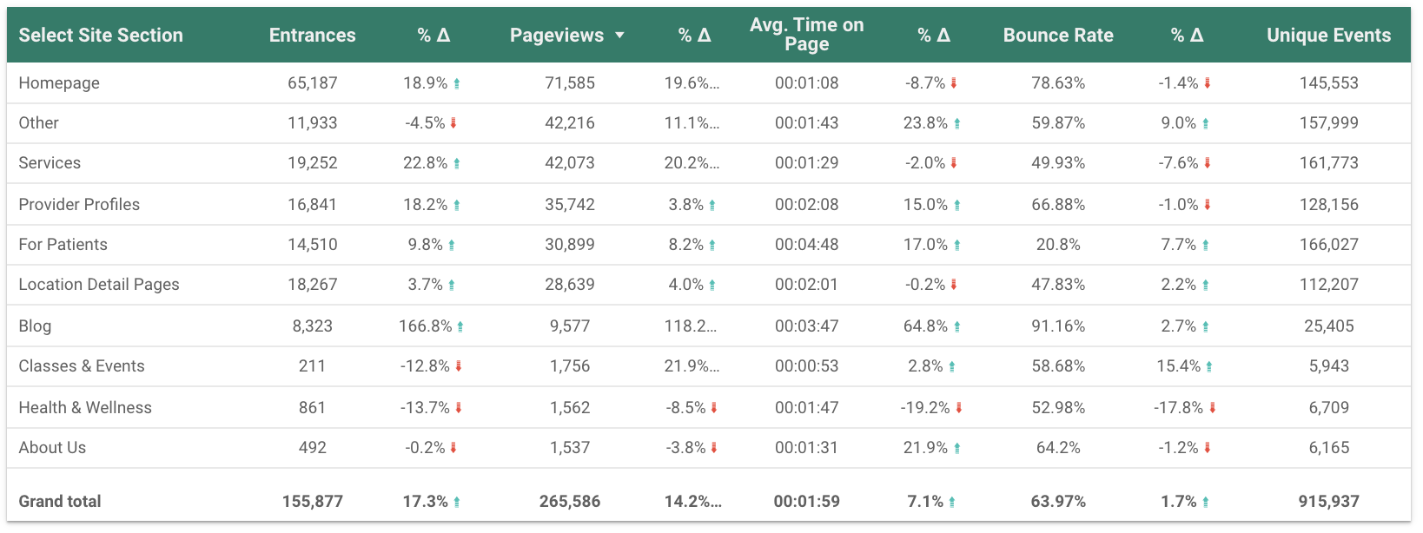
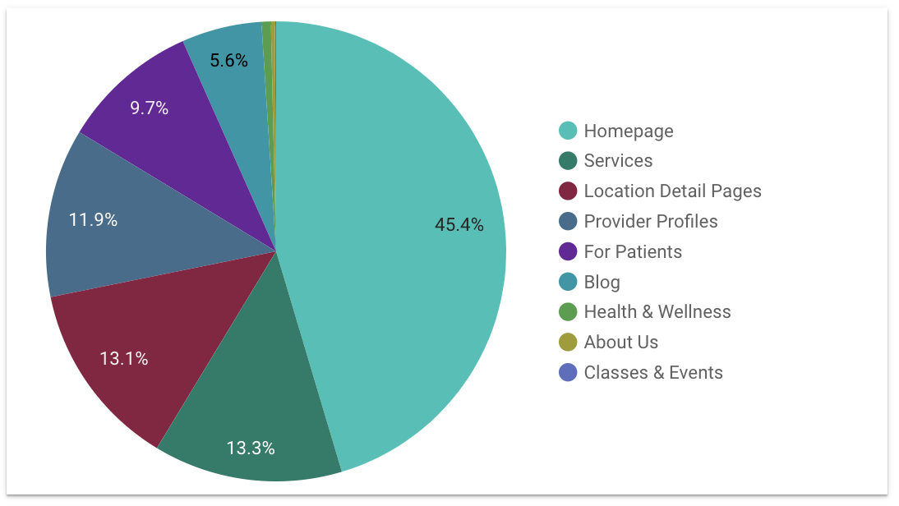
Site Section Performance Check-in | Q4 2021
Traffic by Site Section
166.8% increase in entrances blog
22.8% increase in traffic to services (down significantly since Q3)
18.9% increase in entrances to home page
13.7% decrease in entrances to Health & Wellness (significant improvement over Q3)
Notes:
Q2 Notes:
51.2% increase in entrances to provider profiles
41.2% increase in traffic to location details
34.0% increase in entrances to services
95.9% decrease in entrances to Health & Wellness
Covid testing is in events module
Lifefit events

Slide 8
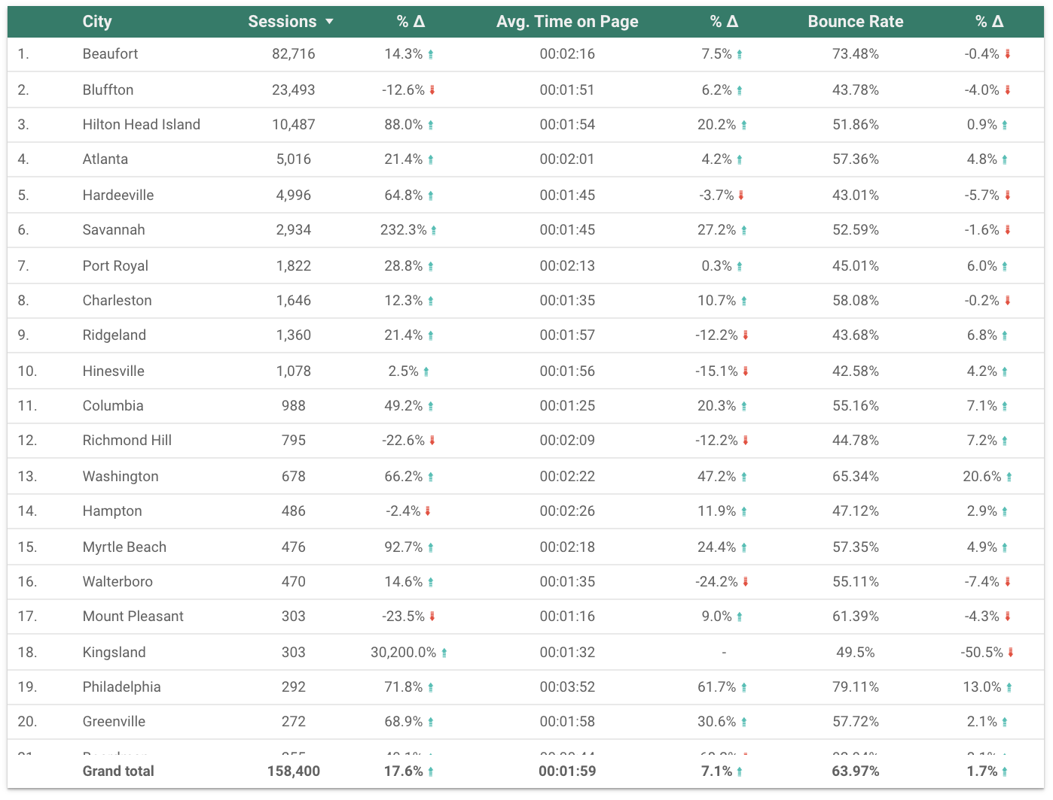
Geographic Performance Check-in | Q4 2021
Traffic by City
30,200% increase in sessions from Kingsland
232.3% increase in sessions from Savannah
71.8% increase in sessions from Philadelphia
23.5% decrease in sessions from Mount Pleasant
Notes:
Q3 Notes:
474.8% increase in sessions from Myrtle Beach
146.3% increase in sessions from Ridgeland
124.1% increase in sessions from Varnville
8.2% decrease in sessions from Greenwood
Q2 Notes:
150.8% increase in sessions from Myrtle Beach
120.9% increase in sessions from Atlanta
104.7% increase in sessions from Ridgeland
68.3% decrease in sessions from Richmond Hill

Slide 9
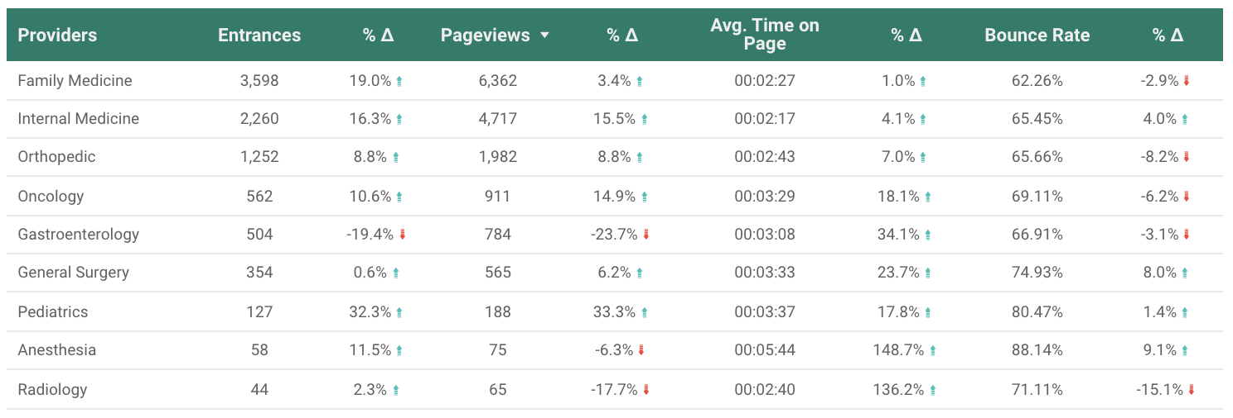
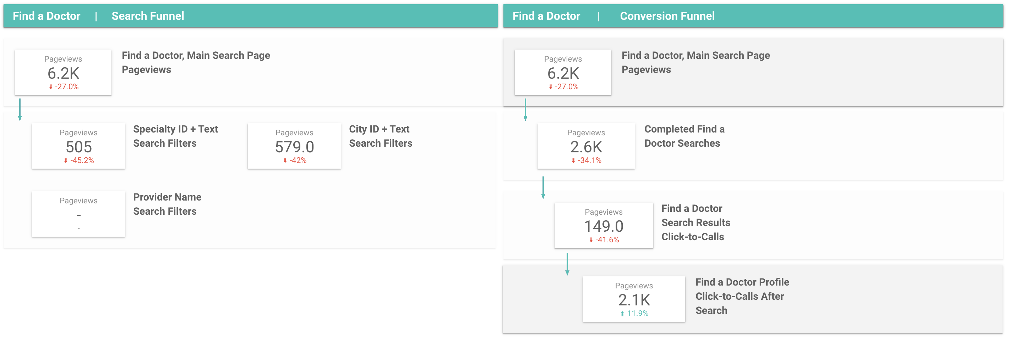
Provider Performance Check-in | Q4 2021
Traffic by Specialty
23.2% increase in entrances for Pediatrics (significant increase over Q3)
19% increase in entrances for Family Medicine
16.3% increase in entrances for Internal Medicine
19.4% decrease in entrances for Gastroenterology
2.1K Provider Click to Calls after search
Notes:
Q3 Notes:
48.2% increase in entrances for Family Medicine
24% increase in entrances for Radiology
23.7% increase in entrances for Internal Medicine
16.2% decrease in entrances for Pediatrics
4.3K Provider Click to Calls after search
Q2 Notes:
125.4% increase in entrances for Family Medicine
69.4% increase in entrances for Gastroenterology
38.9% increase in entrances for Internal Medicine
33.6% decrease in entrances for Orthopedics and Pediatrics

Slide 10
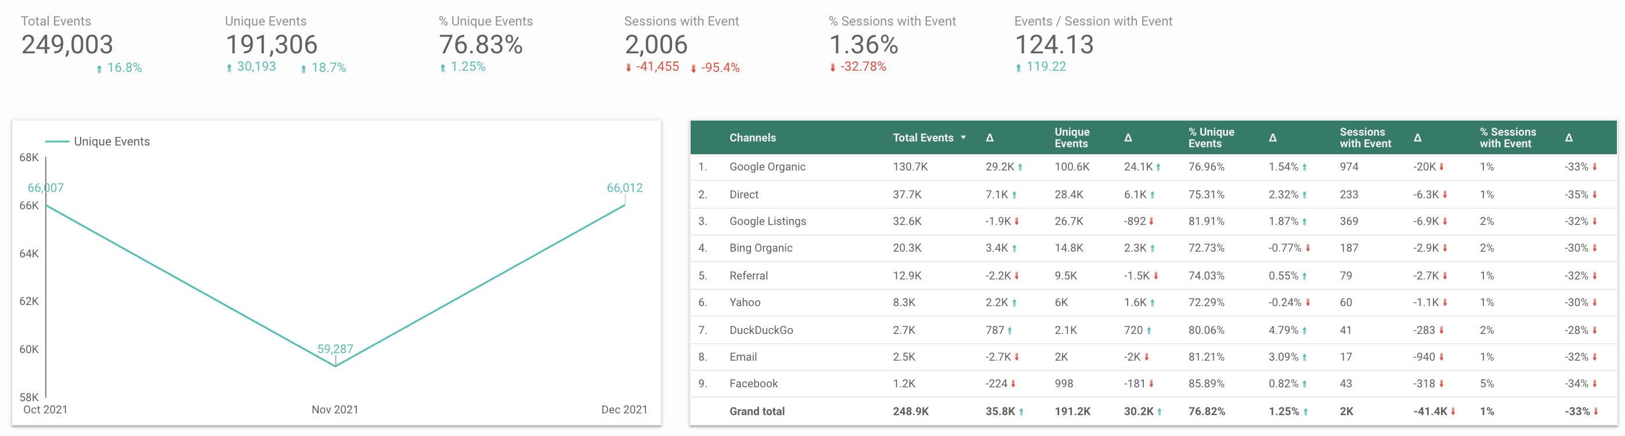
Event Performance Check-in | Q4 2021
16.8% increase in total events
Patient portal and bill pay clicks are most common events

Slide 11
Thank You

