Slide 1
Campaign Landing Pages

Slide 2
Background & Purpose of Standardized Campaign Landing Pages
Consistent look and feel and standard web forms
Too much reliance on vendor partners
Contributes directly to saving costs, time, and effort
  Average campaign landing page and form developed by vendors costs ≈ $5,500
  Average campaign has 2 – 3 landing pages (one for each CTA).
  In FY19, Trinity Health had approximately 42 campaigns costing a total of ≈ $126,000
  In Q4 of FY20 alone, Trinity Health was able to save ≈ $93,000 using the new templates

Slide 3
Campaign Landing Page Best Practices
Big CTAs above the fold
Directional cues to CTAs
One focus per landing page
Echo other sites/materials with graphics, colors, fonts, etc. to easily identify and recognize brand
Use lifestyle-focused photos
Use video content when available
Headlines should match paid ads
Simplify copy with bullets when possible

Slide 4
Web Form Best Practices
Fields should be specific to the call-to-action
Reduce number of fields and indicate those that are required
  5 fields or fewer if possible
  Only use required fields for matching in CRM, when applicable
    First Name, Last Name, Email, Zip Code, Birthdate
Include a privacy message or link
CTAs for forms should be visible and clear what action is needed

Slide 5
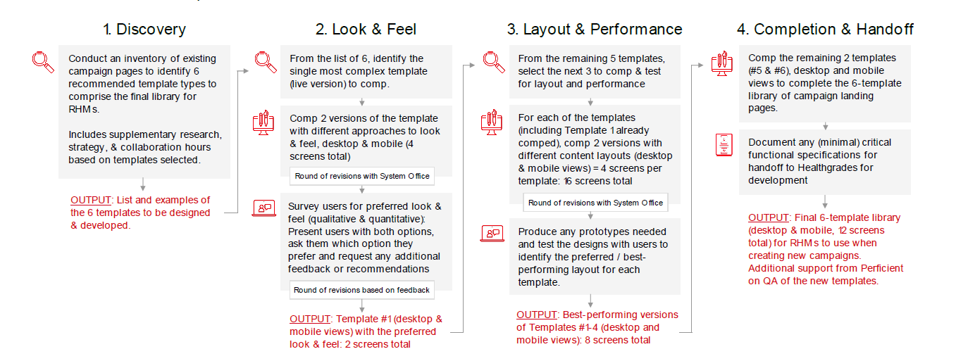
What Trinity Health Did

Slide 6
Final Templates
Layout A:
https://perficient.invisionapp.com/share/6PRYOHKQFUA#/screens/376345922
Layout B:
https://perficient.invisionapp.com/share/6PRYOHKQFUA#/screens/385540717

Slide 7
CRM Integration with Formstack for Campaign Landing Pages
Formstack is our EIS-approved, HIPAA-compliant third party platform for form creation
  Form creation with logic
  Workspaces
  Portals
  Surveys
Named default form option for our website vendor
Integrated into Healthgrades CRM via a webhook
Allows system to send to multiple users without having additional CRM licenses or training

Slide 8
End-to-End Data Flow
Campaign, assets, tactics, web form developed in CRM
Web form developed using CRM campaign values in Formstack
Campaign landing page developed with Formstack form embedded
Campaign tactics placed
Formstack immediately sends user info to CRM via secure webhook integration
Legend:
User interacts with tactics
User information is sent to Formstack
Marketing team
Users
Web Leads
User completes form
User visits campaign landing page

