Slide 1
Developing a Unified Consumer Website
Cassi Snyder
Trinity Health

Slide 2
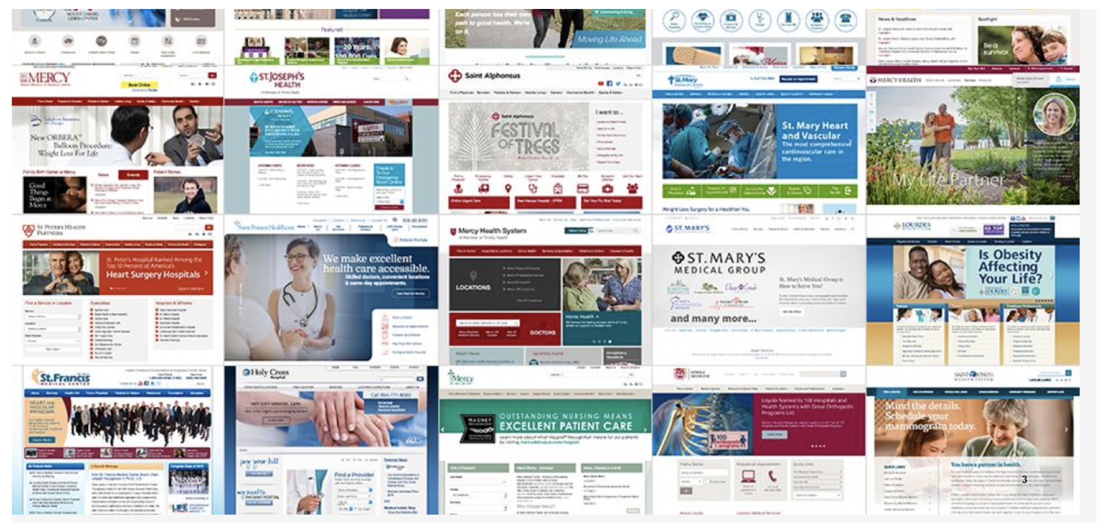
Reason: Disparate architectures and UX
Notes:
9 different platforms
Variation in user experience
21 different designs
Navigations built for the departments and physicians and corporate departments – not for users

Slide 3
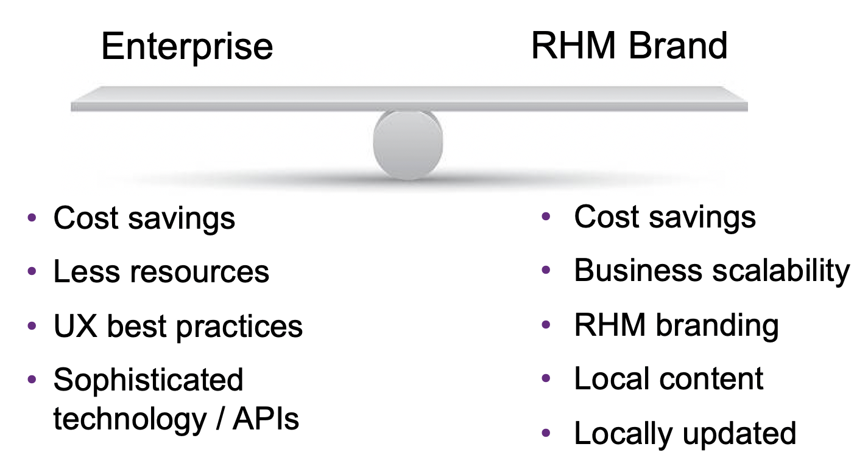
Strategy and Goals
Vision: Build beautiful and inspiring digital front doors to our health systems
Keys to Success: Balanced and people-focused

Slide 4
Business Case
2 main business case components:
  Greater overall volume of site visits leading to new patient acquisition
  Cost efficiencies from more self-service (less calls to call center)

Slide 5
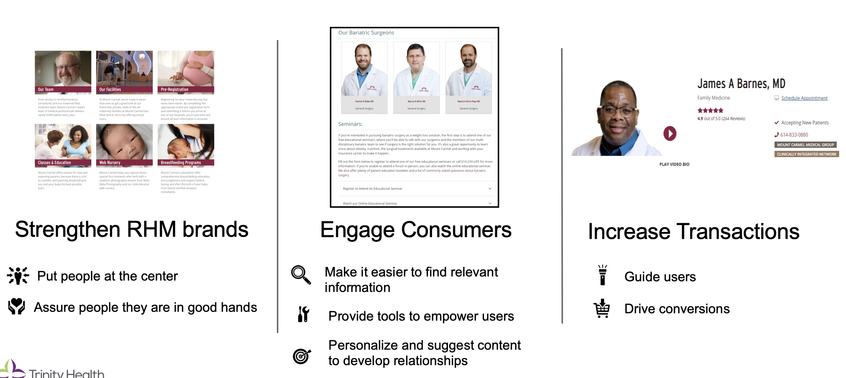
Main Goals

Slide 6
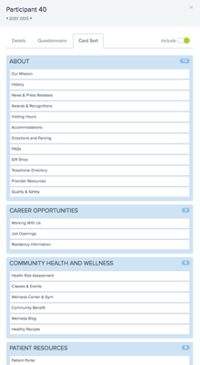
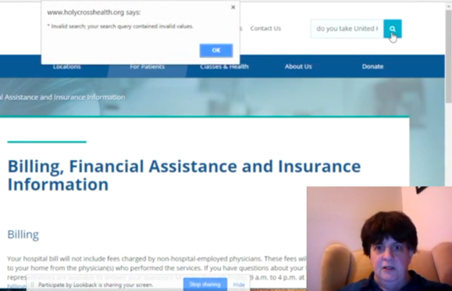
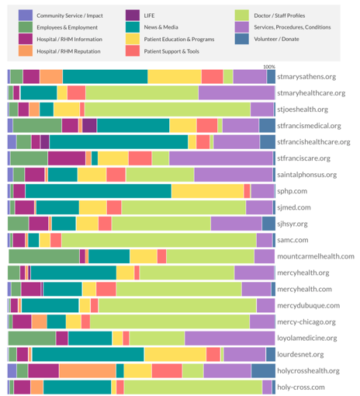
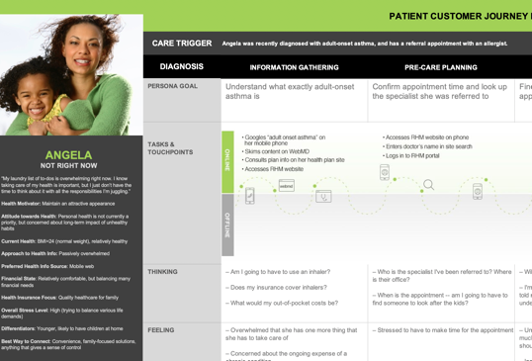
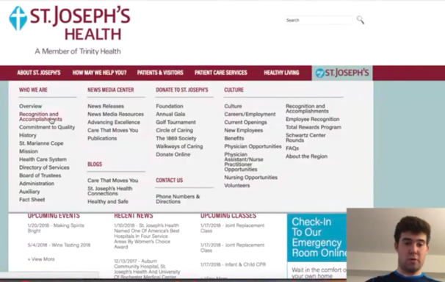
Research Process
Early Discovery Work:
User Testing of 6 Live RHM Sites (5 participants each)
Card Sort & Information Architecture
Content Gap Analysis, Personas, Strategic Framework, Design Concepting, & more

Slide 7
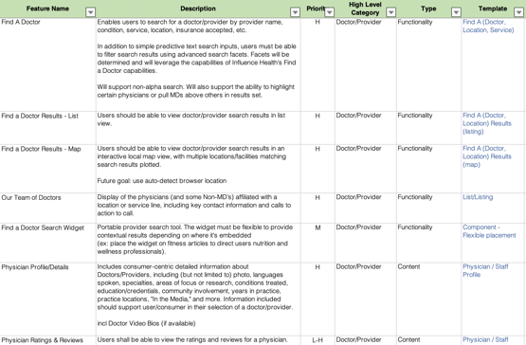
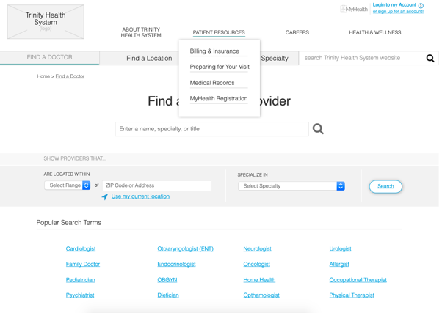
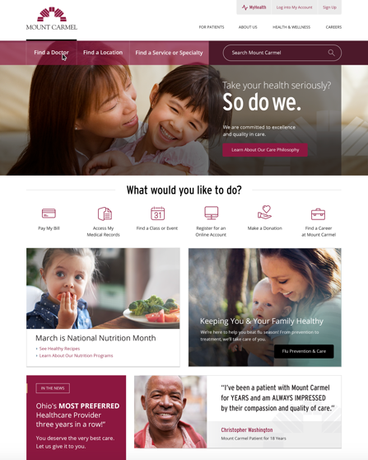
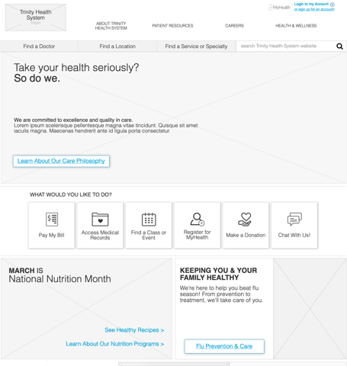
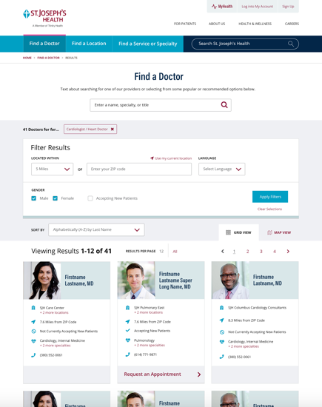
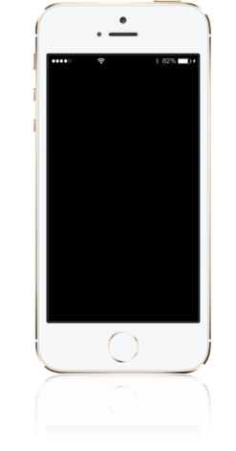
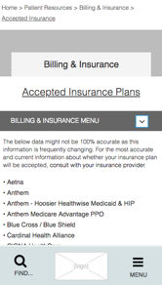
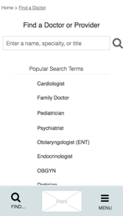
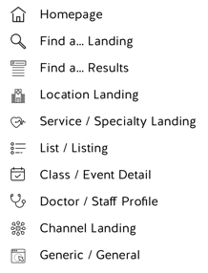
User Testing and Design Comp Development
Use Feature Set to
Wireframe 10 Templates
25 Desktop User Tests
7 Guerrilla Mobile Tests
Visual Designs Using Two
RHM Brands
Notes:
15 page templates
Style guide

Slide 8
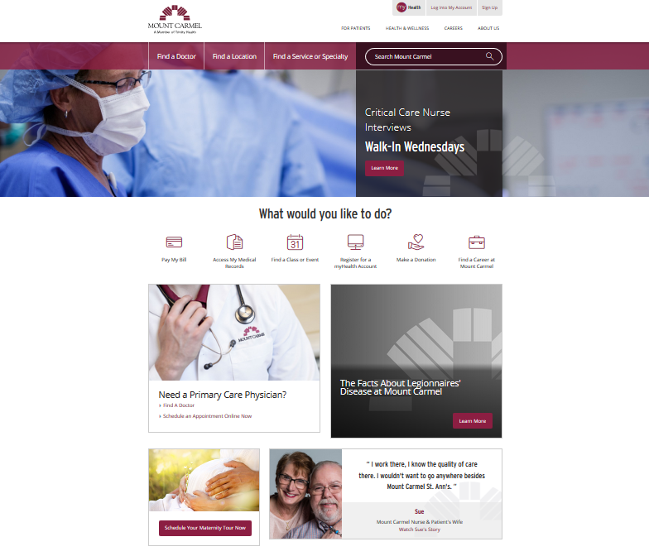
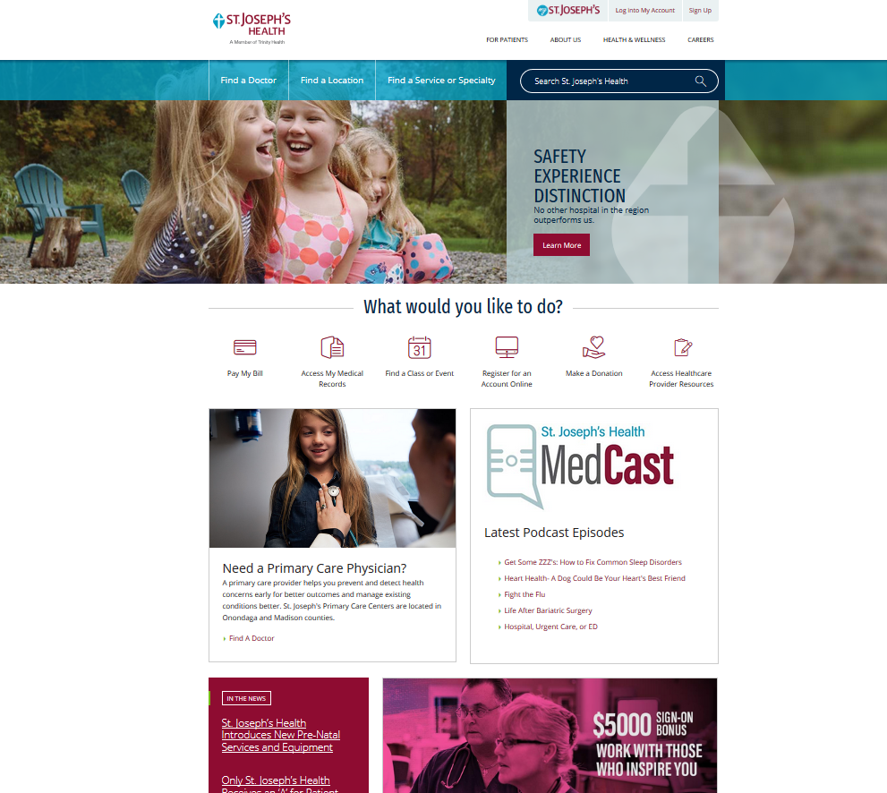
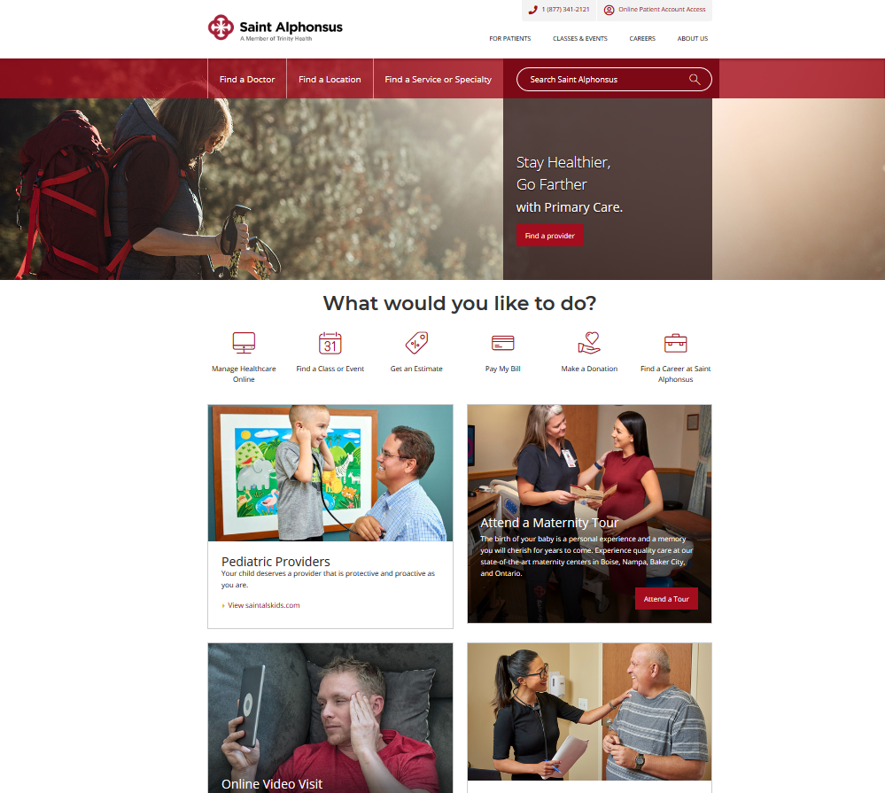
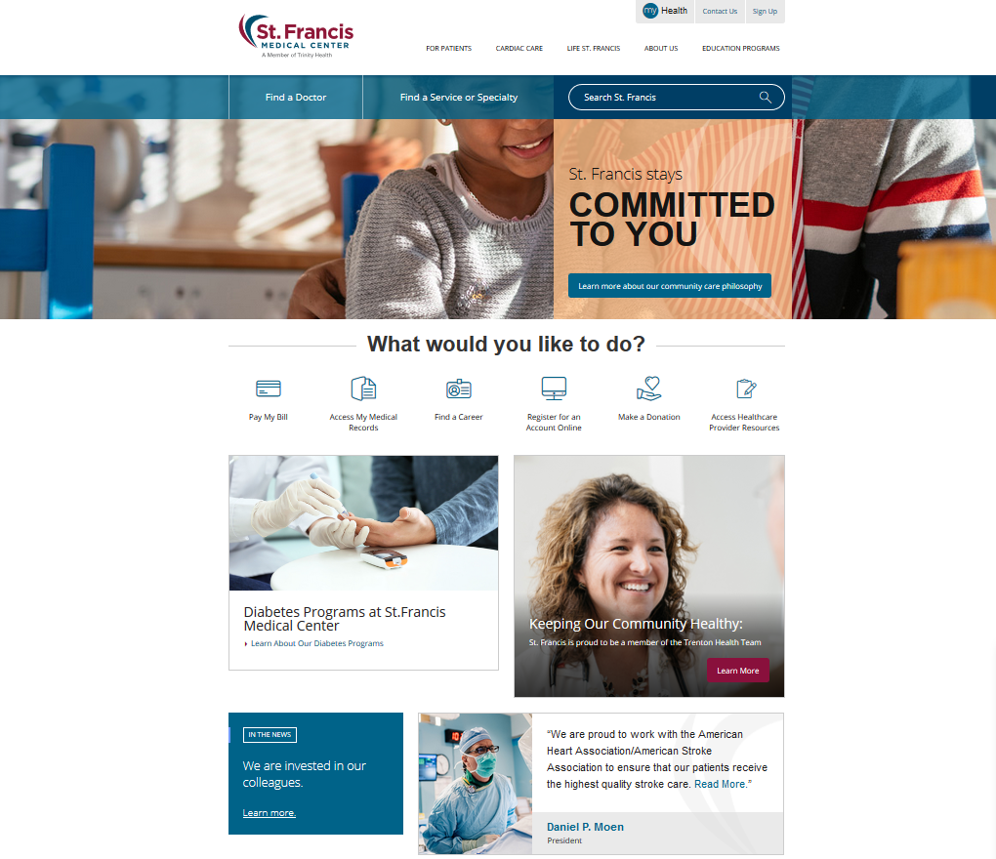
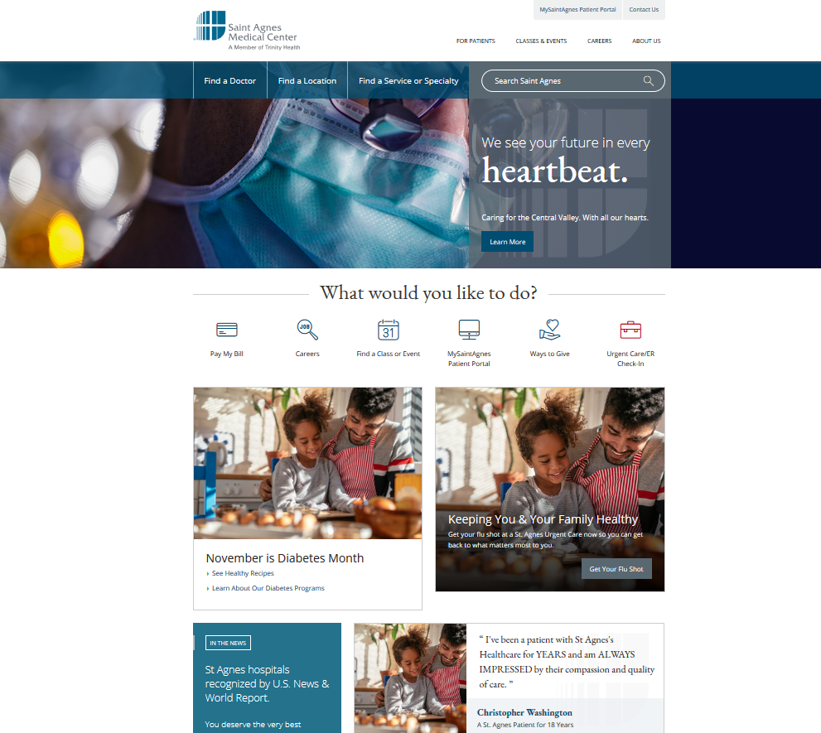
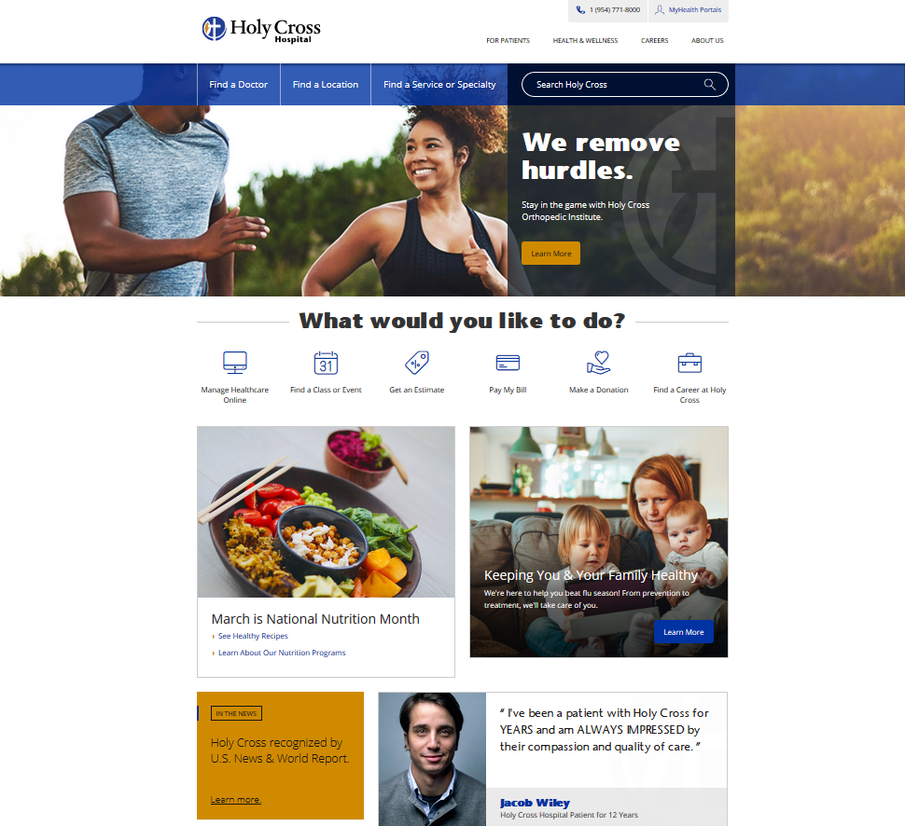
Site Snapshots Today

Slide 9


Website Awards Won
2019 Gold Hermes​
Category: Electronic Media / Social Media / Interactive Media | Website Overall | Medical
2019 Silver Muse​
Category: Website​
Sub-Category: Health
Notes:
The Hermes Awards recognize excellence in concept, writing, and design in marketing materials and communication ranging from traditional media to emerging technologies.​
​
The Muse Awards recognize a wide variety of categories including websites, mobile apps, advertising and social media campaigns, audio and video, and even corporate social responsibility programs. Other 2019 winners include projects for Nike, Disney, Girl Scouts of America, and Prime Video.

Slide 10
UX Driving More Conversions
Event | # of Instances | % Change YOY
Phone Link Clicks | 3,160 | h10%
Get Directions Clicks | 377 | i3%
MyHealth Button Clicks | 722 | h8%
MyHealth Login Clicks | 5,302 | h7%
MyHealth Sign Up Clicks | 1,558 | h10%
Show Map Clicks | 1,067 | h14%
Email Link Clicks | 74 | h18%
ER Check-In Clicks | 179 | h9%
***10/21/19 – 11/19/19 compared to same time period of previous year

Slide 11
Personalized Content
Deliver targeted messages and content to users based on parameters set directly in the platform
Dynamically serve the right content to the right audience on the right device, at the right time
Target users based on ambient or behavioral data

Slide 12
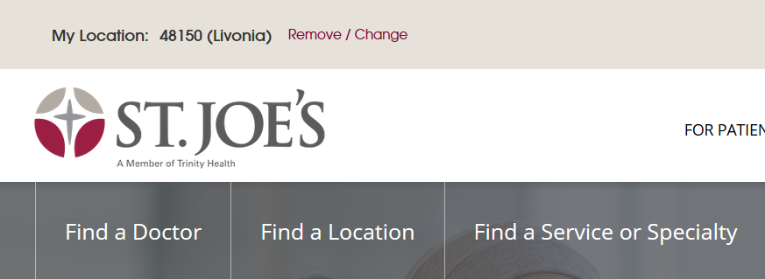
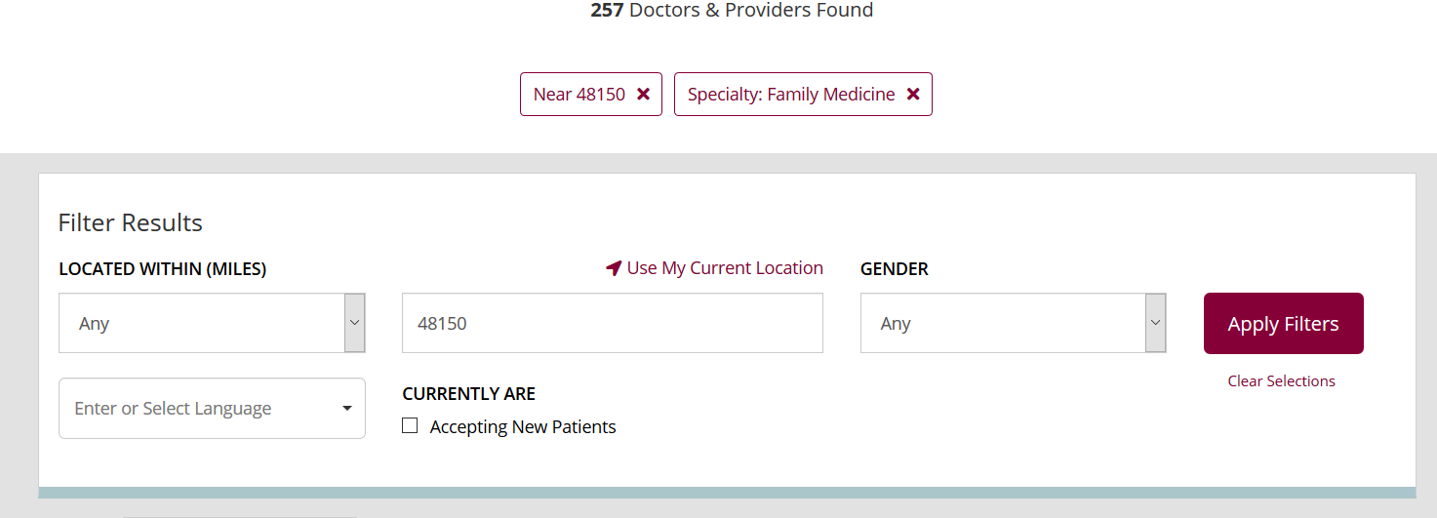
Localized Content Example
Allow users to input their location to receive doctors and locations closer to them as well as snippets of content throughout the site that are pertinent to the chosen location

